Slide 1
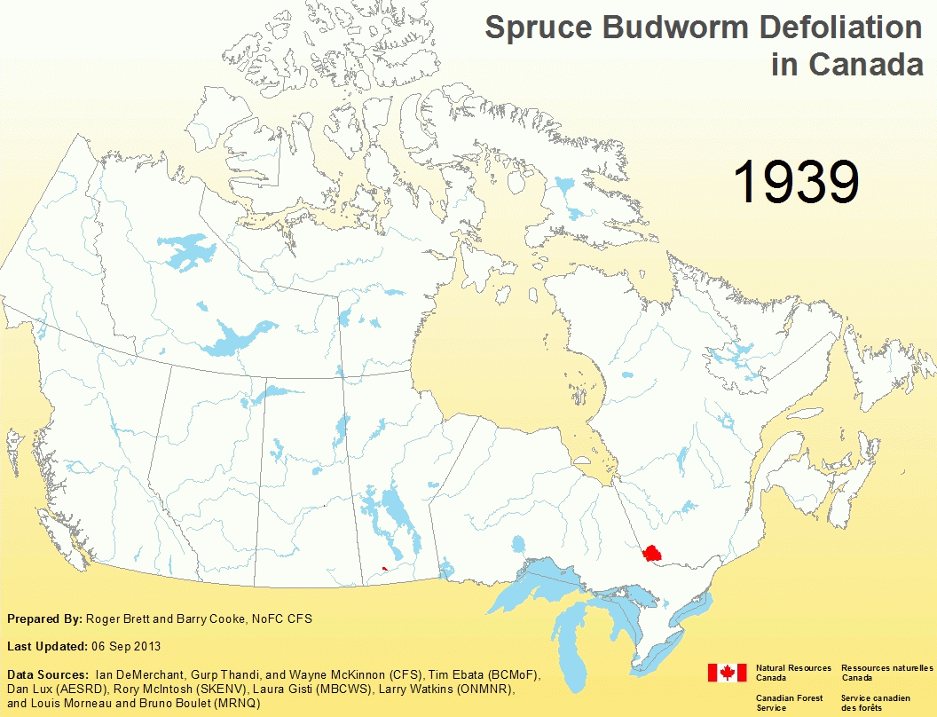
(1939-2012)
Notes:
We are in the process of compiling updated national maps of the annual occurrence of major pests. This example is for SBW, but we are almost ready to release data for FTC and MPB. Important to note that annual occurrence of defoliators does not translate directly to volume loss. Additional computational tools are required to go that extra step.

Slide 2
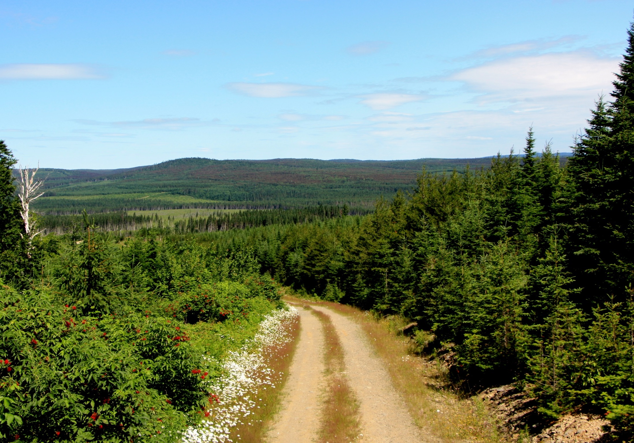
‘Early Intervention Strategy’ for Spruce Budworm:
A novel approach to an old problem
R. Johns, V. Martel, D. Pureswaran
Atlantic Forestry Centre, Canadian Forest Service
CBC digital archives 1957

Slide 3
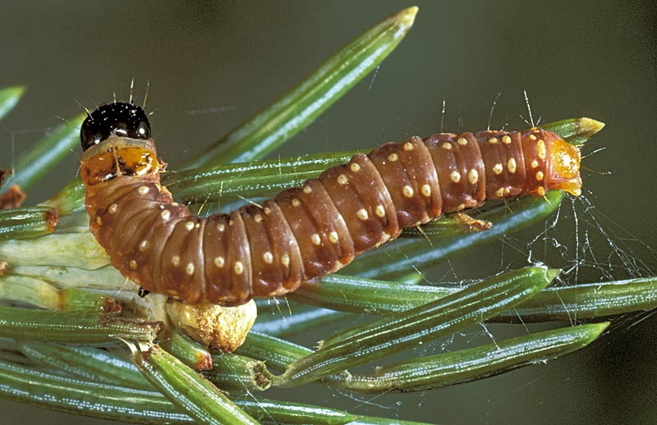
Spruce budworm, Choristoneura fumiferana

Slide 4
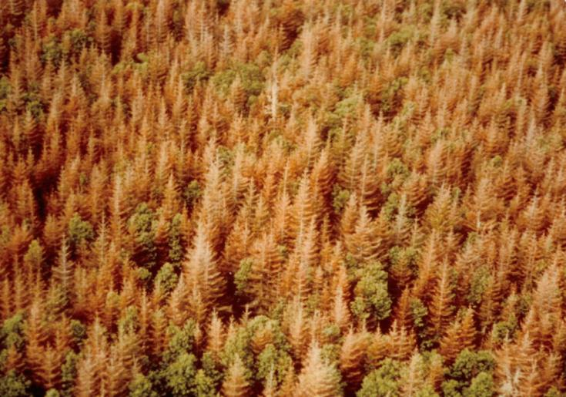
Cape Breton Highlands, 1977 (Ed Kettela)

Slide 5
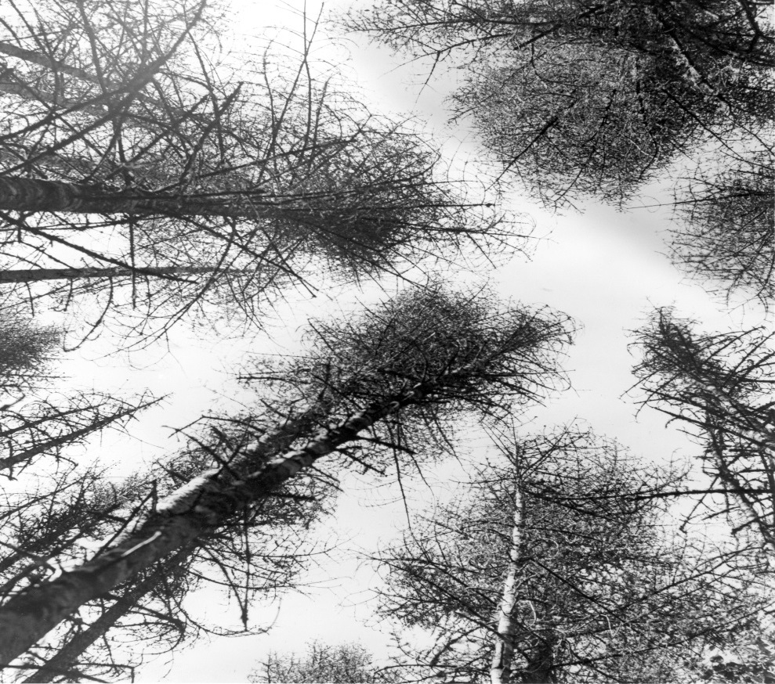

Slide 6
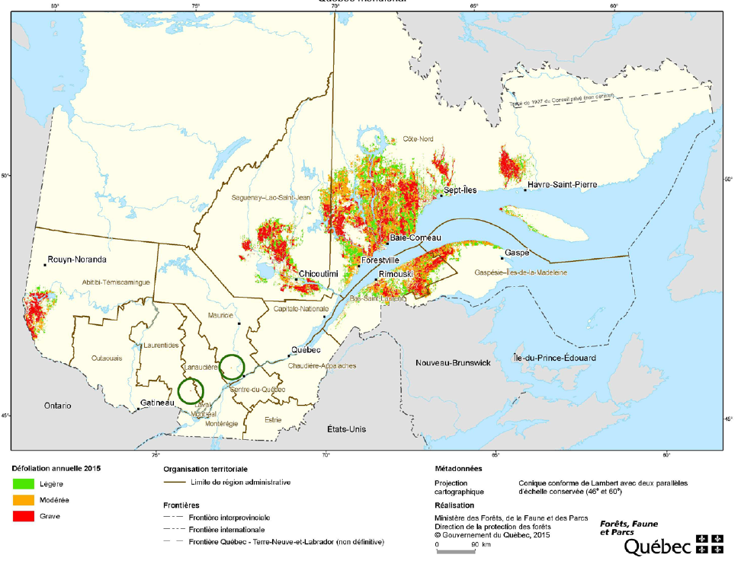
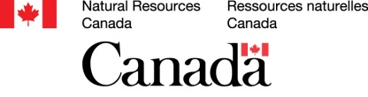
Foliage Protection Strategy
Early Intervention Strategy
Containment?
How to manage budworm?

Slide 7
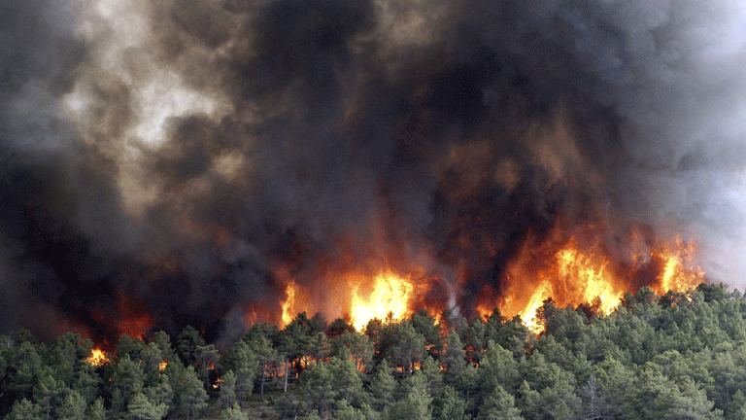
Foliage Protection
Early Intervention

Slide 8


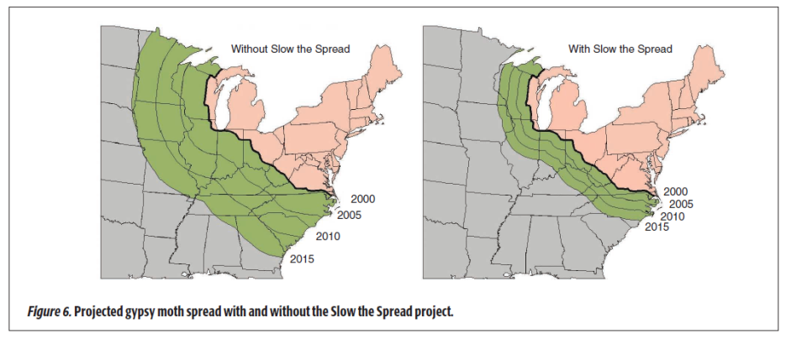
“SLOW THE SPREAD” PROGRAM
GYPSY MOTH
USDA 2007 General Tech. Report (NRS-6)

Slide 9
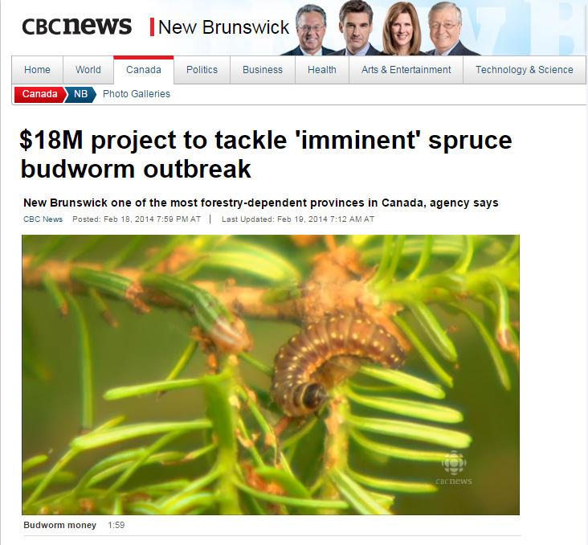

Slide 10
Early Intervention Strategy
Criteria for feasibility:
  Population dynamics
  Monitoring: Detection at low densities
  Efficacy and non-target effects
  Communication and outreach
  Benefits > costs

Slide 11
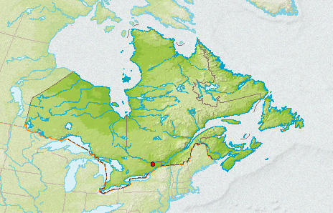
Oscillatory Hypothesis
Foliage protection Strategy

Slide 12
Epicentre Hypothesis
Early Intervention Strategy

Slide 13
Early Intervention Strategy
Criteria for feasibility:
  Population dynamics
  Monitoring: Detection at low densities
  Efficacy and non-target effects
  Communication and outreach
  Benefits > costs

Slide 14
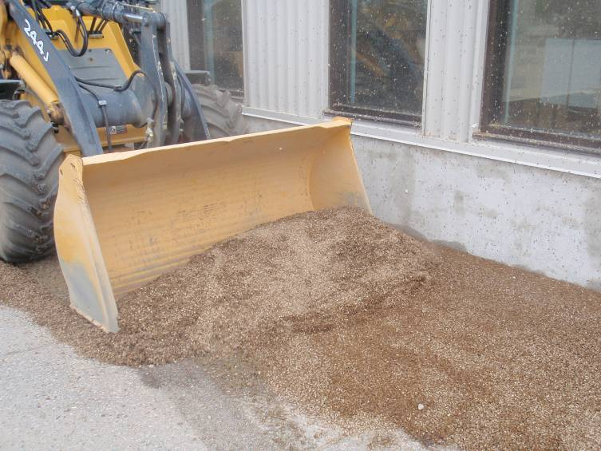
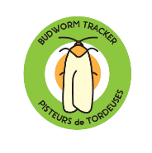
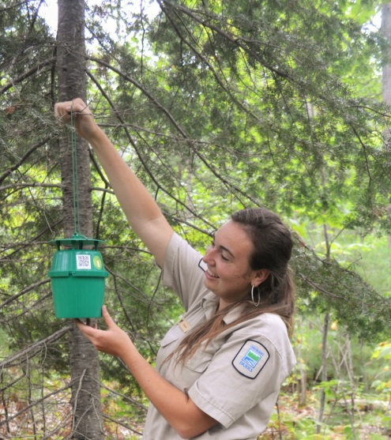
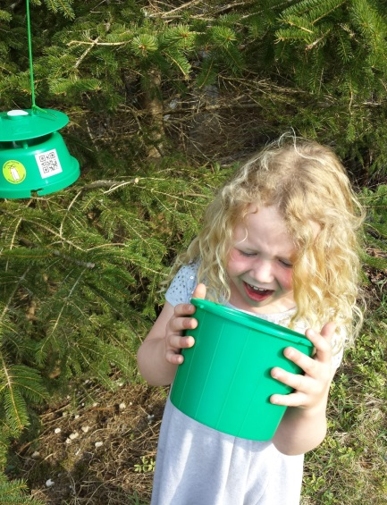

Slide 15
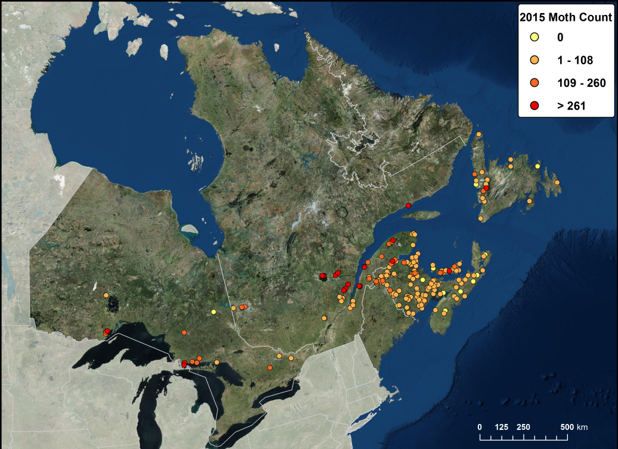
2015
294 ‘Trackers’ - 26,923 moths
89% return rate

Slide 16
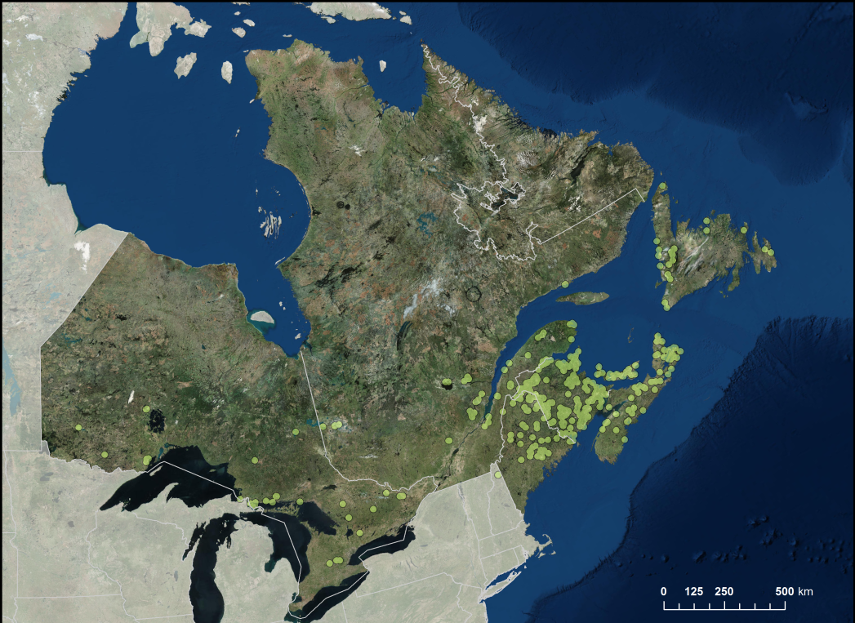
2016
~400 traps sent out
~$60 per kit (mailed out and samples returned)

Slide 17
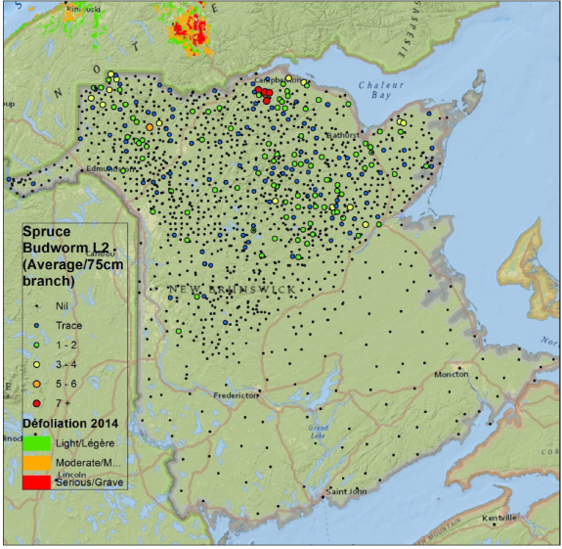
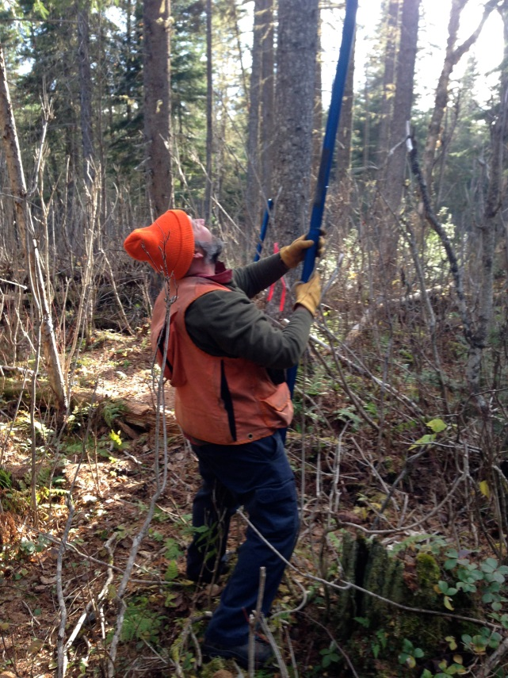
Monitor hibernating larvae (L2)
2015

Slide 18
Early Intervention Strategy
Criteria for feasibility:
  Population dynamics
  Monitoring: Detection at low densities
  Efficacy and non-target effects
  Communication and outreach
  Benefits > costs

Slide 19
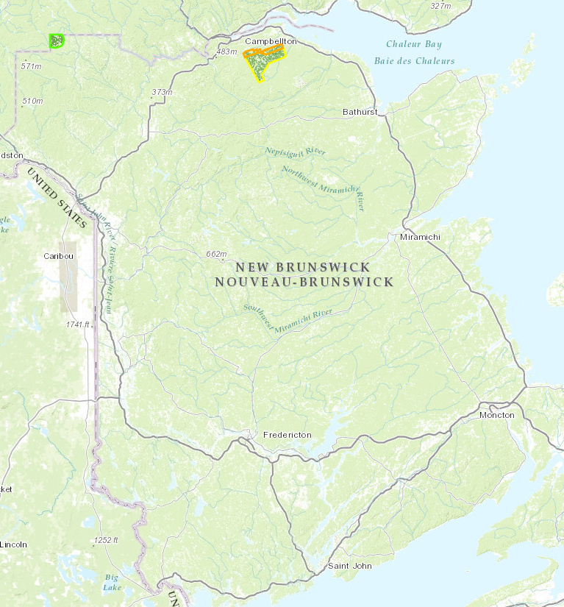
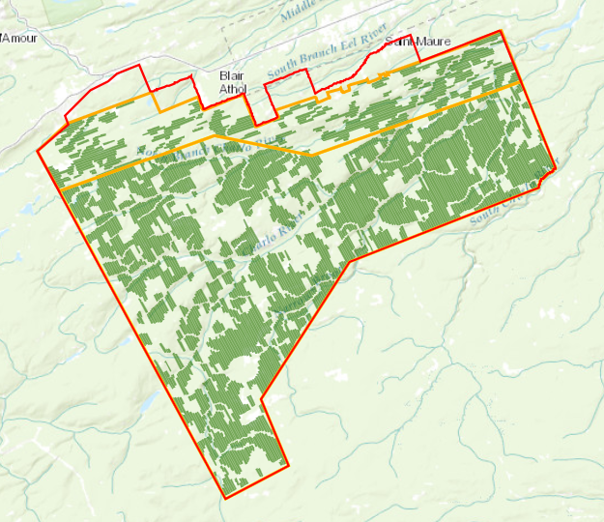
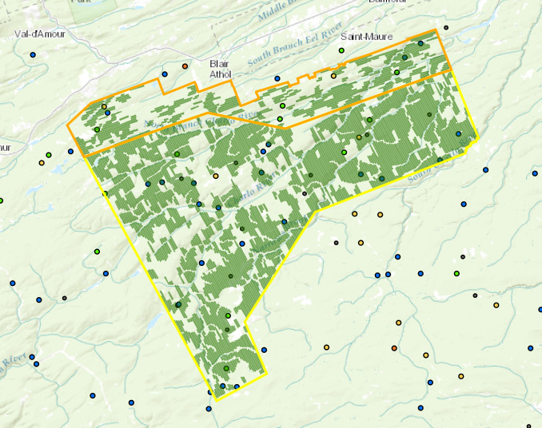
Efficacy Trials (Double Btk - 2015)
Site effects
Landscape effects

Slide 20
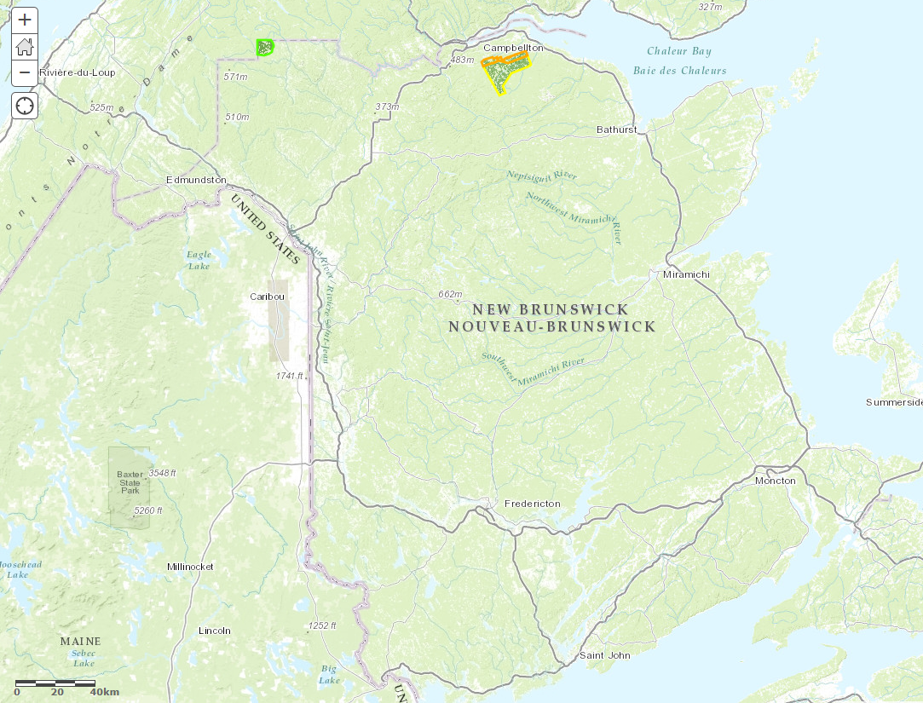
Landscape
effects
Notes:
Efficacy evidence (for 2015 only). Represented as the % change in L2 density from one season to the next following treatment. The data used here is from plots in the buffers and surrounding areas (within~5km of the treatment area) vs. plots within the treated areas.

Slide 21
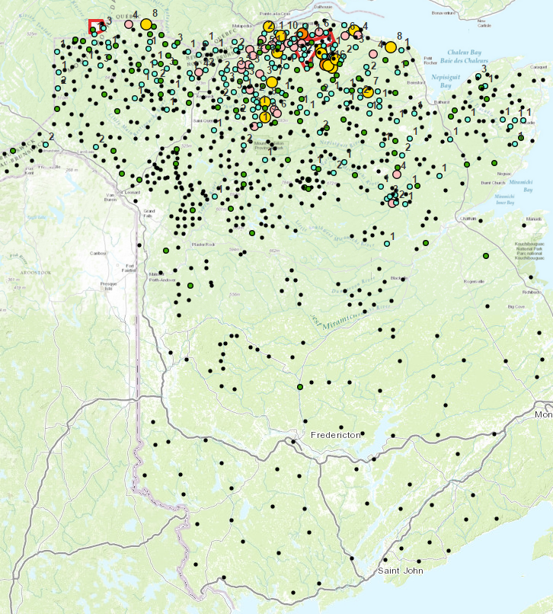
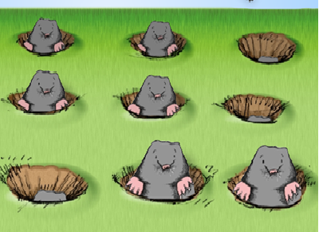
Efficacy Trials (2016…to be continued)

Slide 22
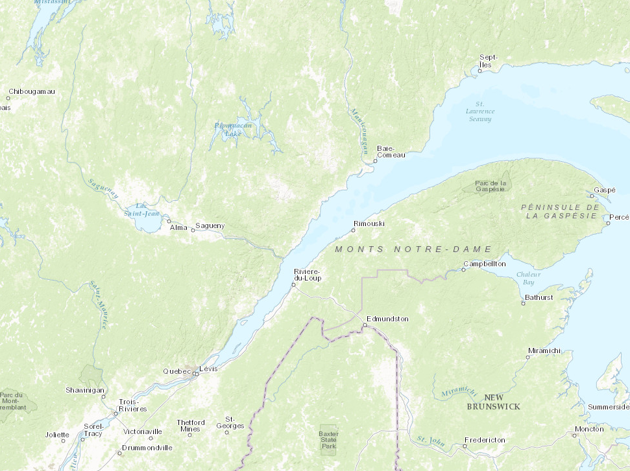
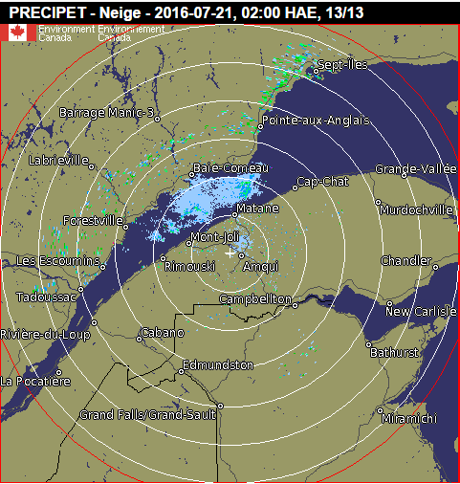
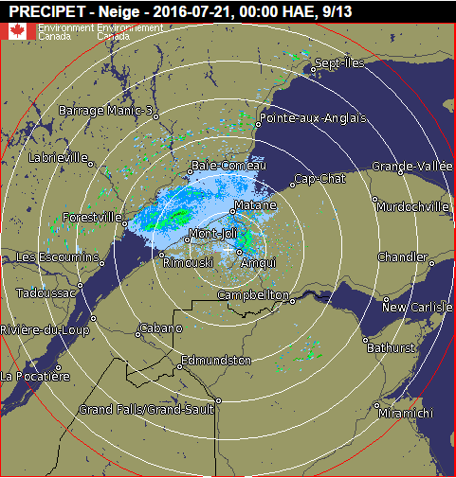
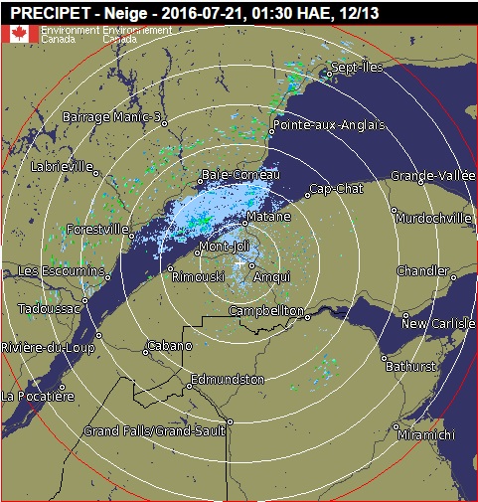
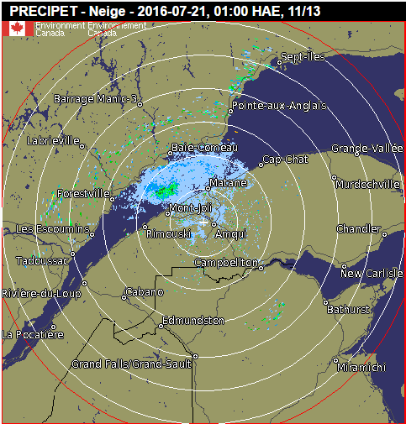
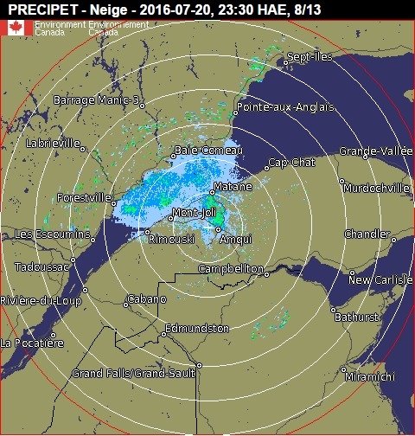
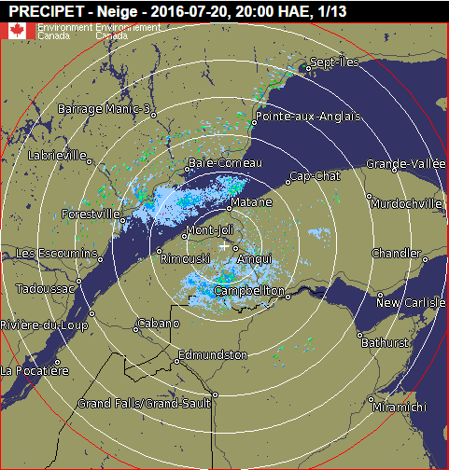
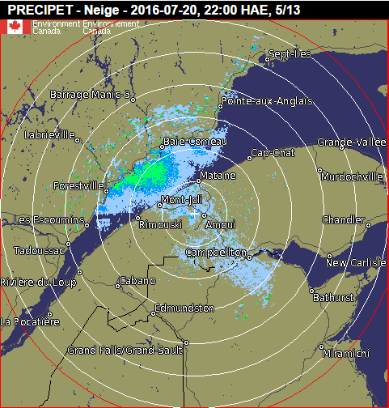
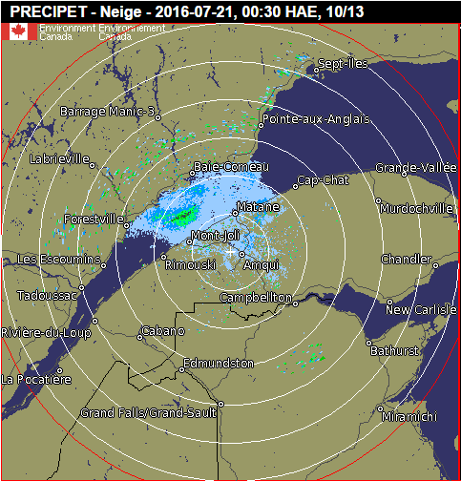
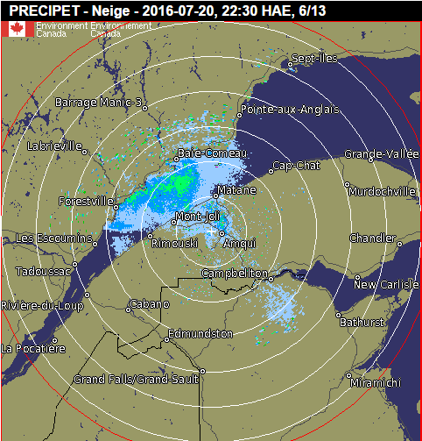
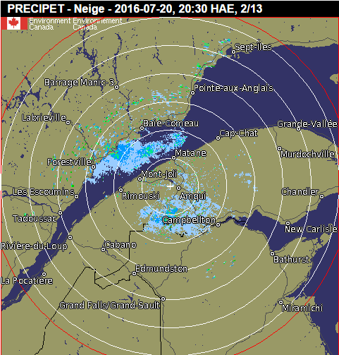
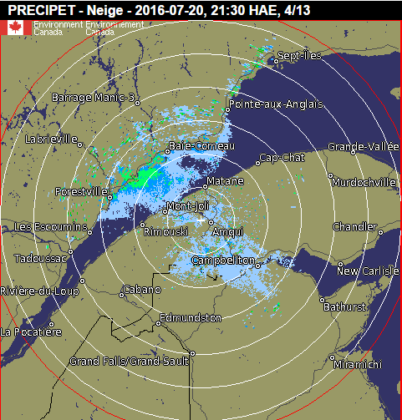

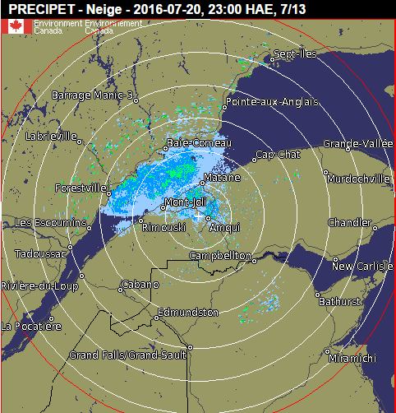

Slide 23
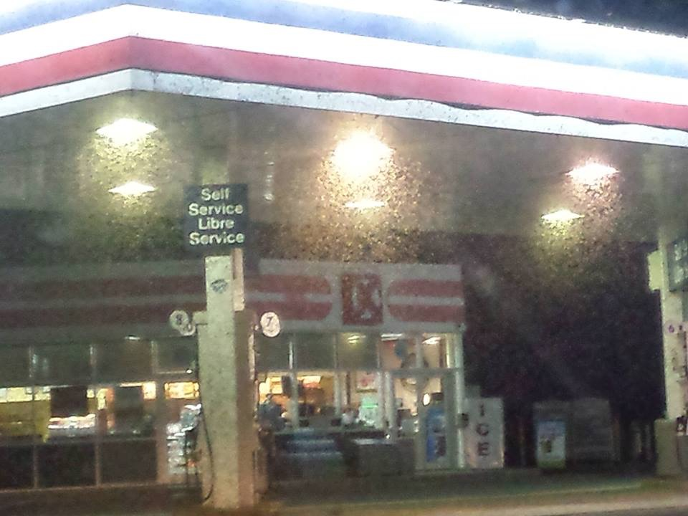

Slide 24
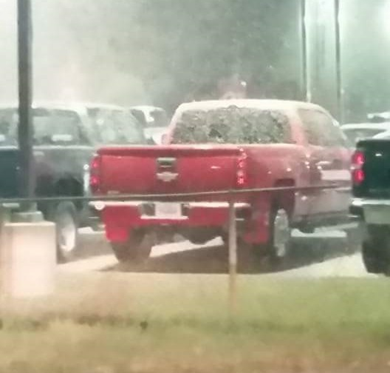
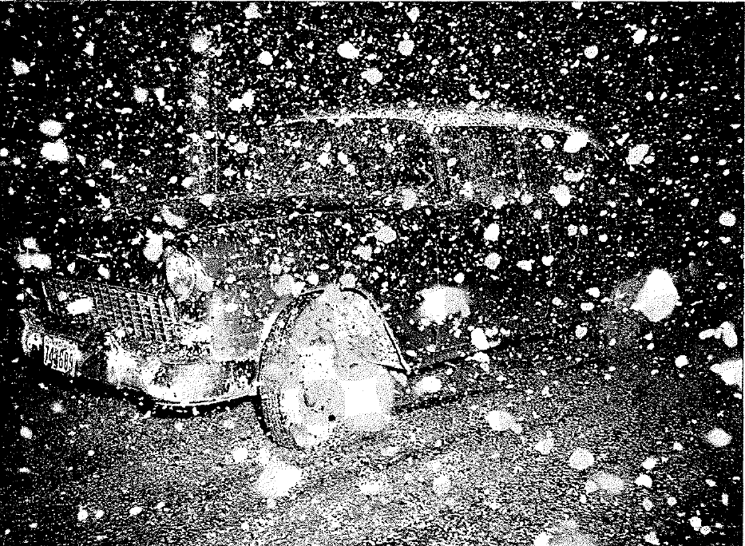
Campbellton 2016
Campbellton 1957

Slide 25
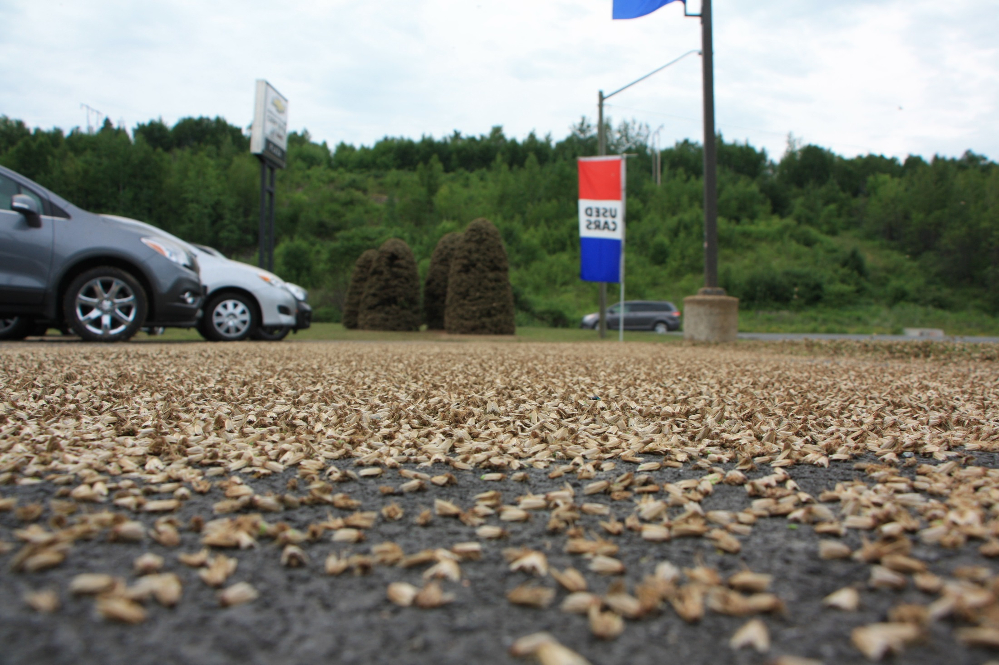

Slide 26
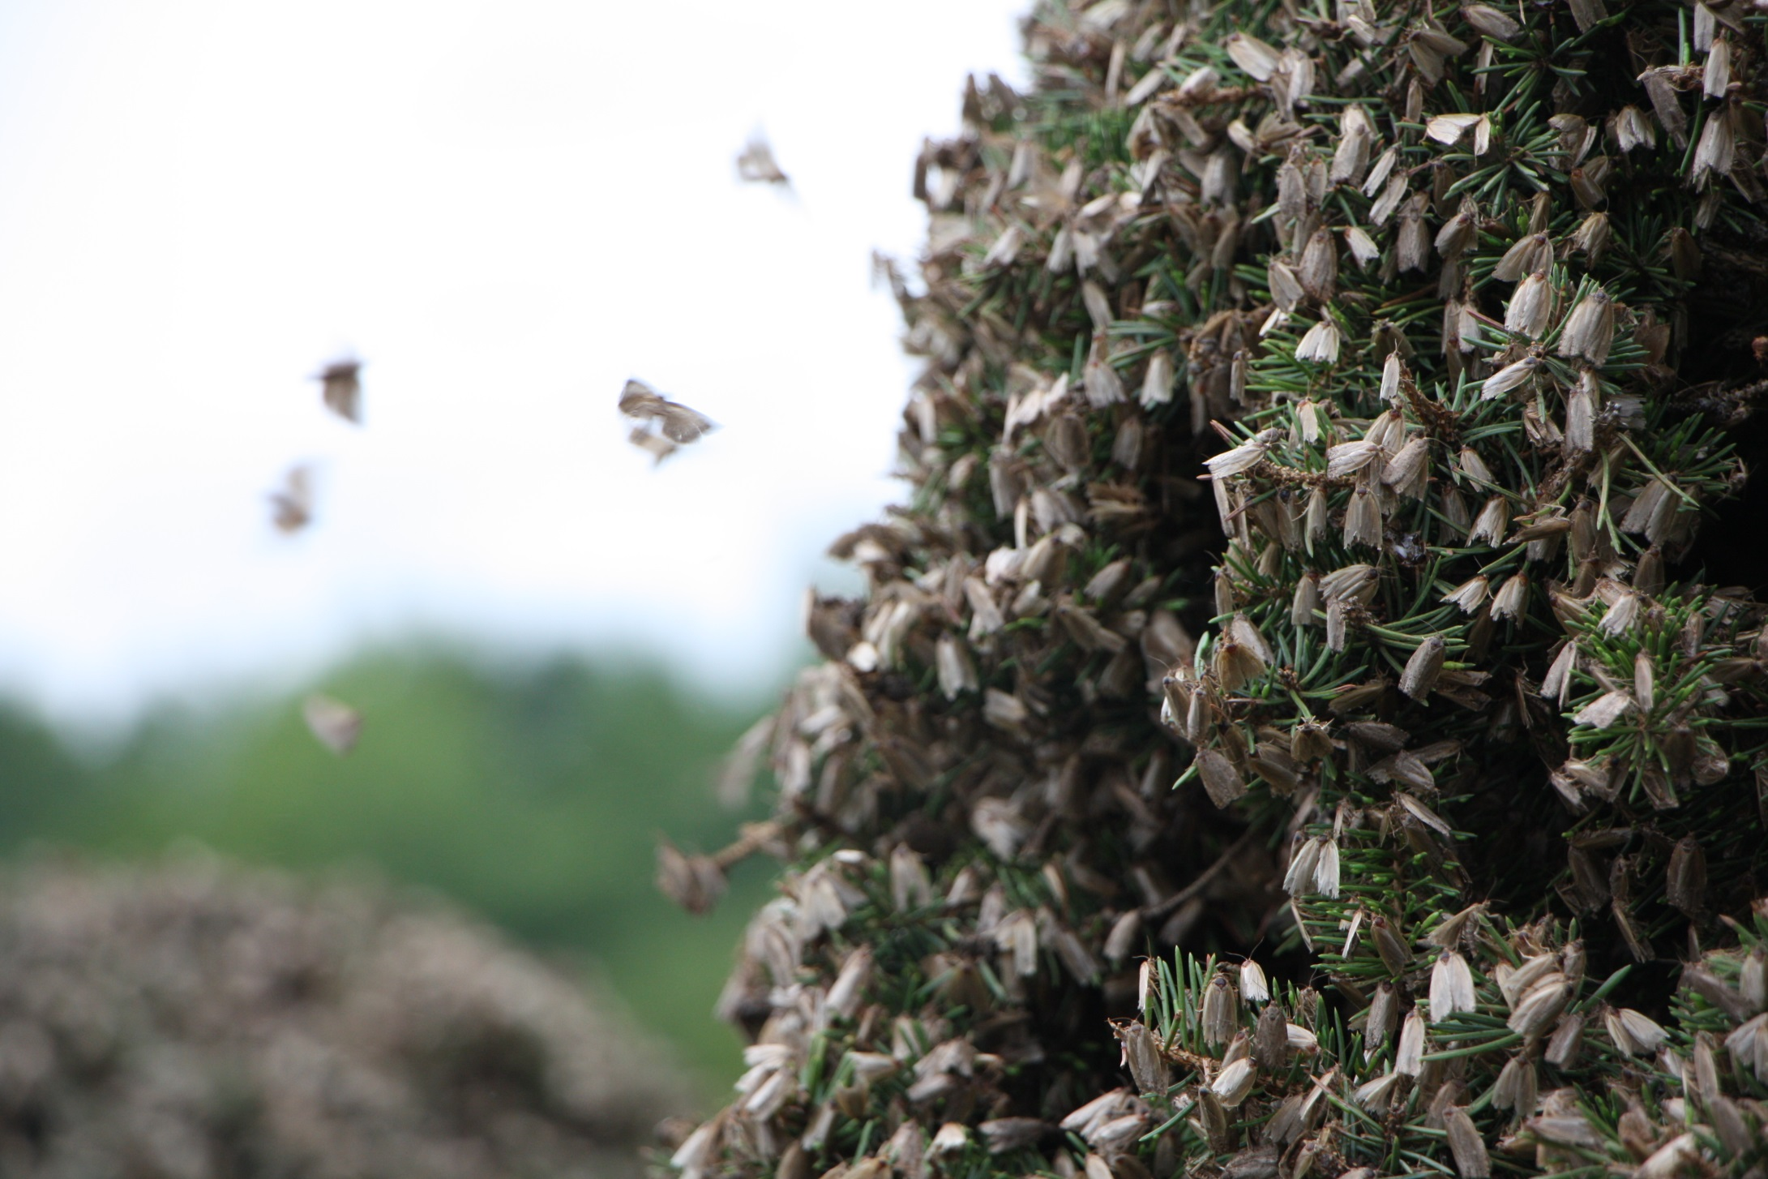

Slide 27
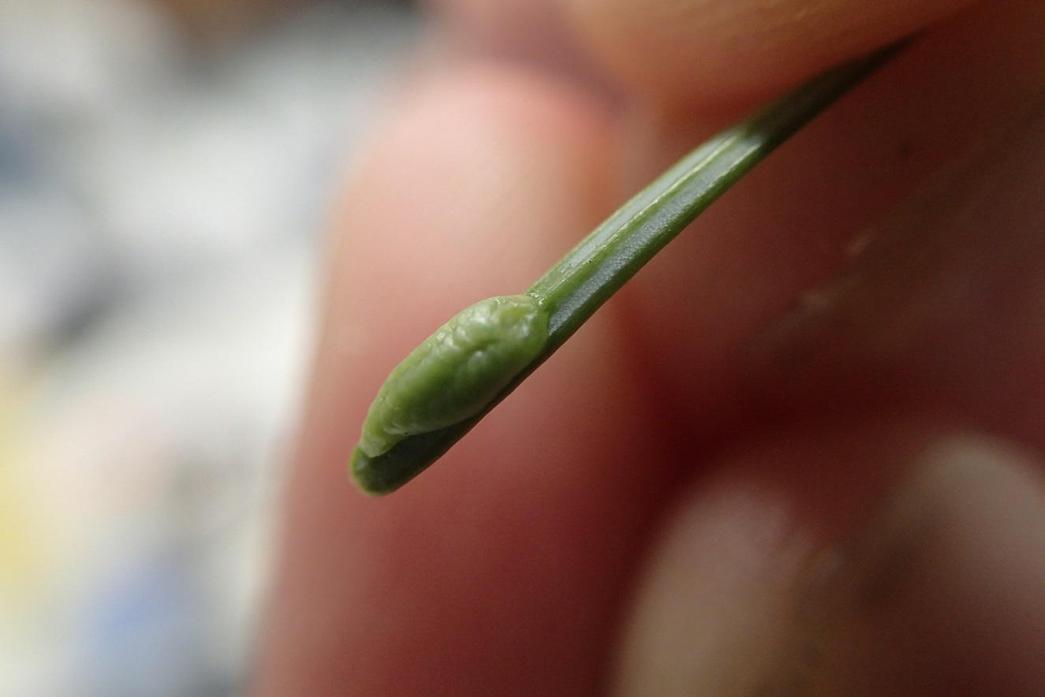
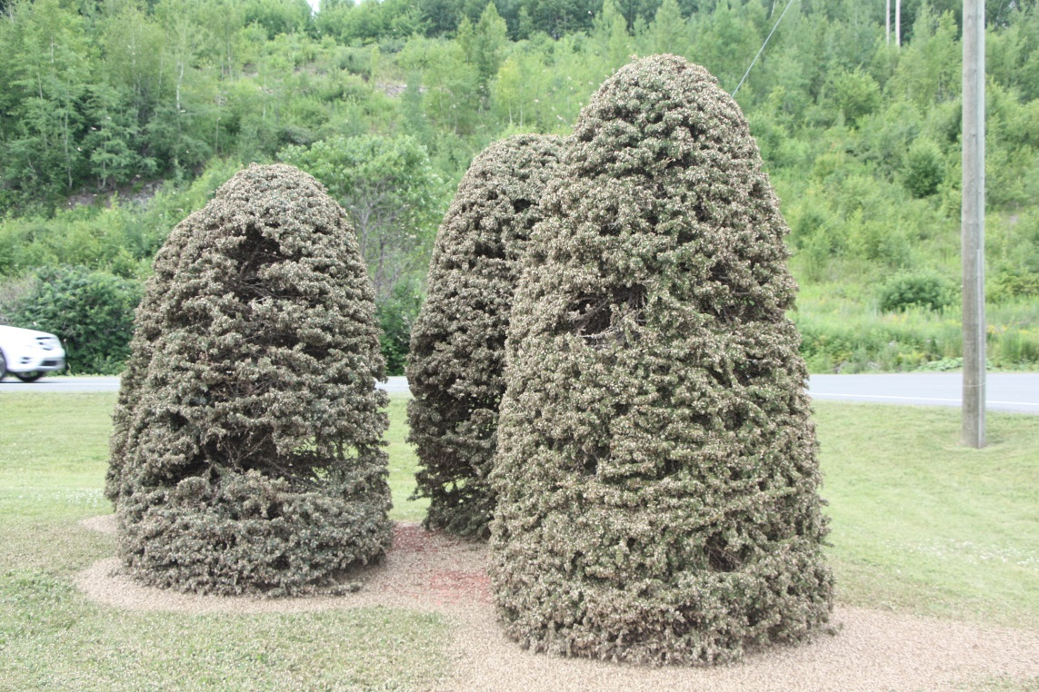
Mass Dispersal Event in Campbellton
  80% female moths.
  ~500 egg masses (~10,000 eggs) per 10 cm branch tip!

Slide 28
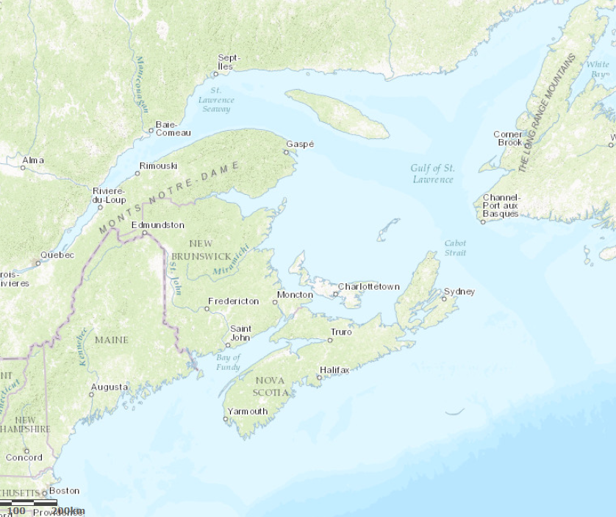
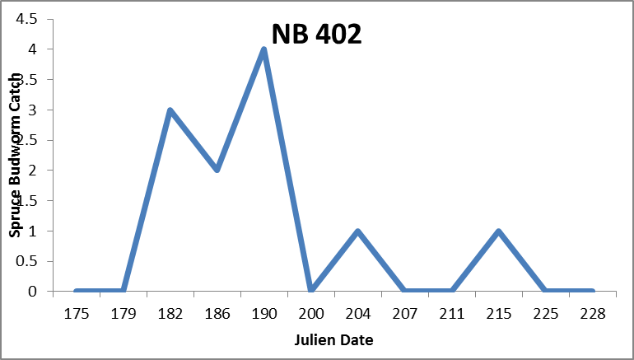
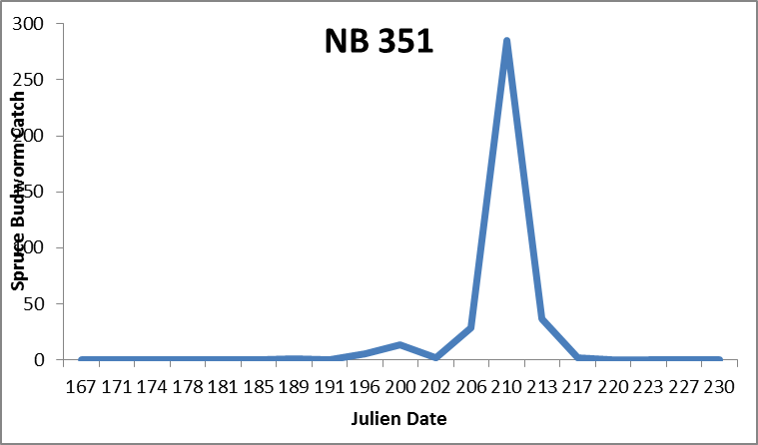
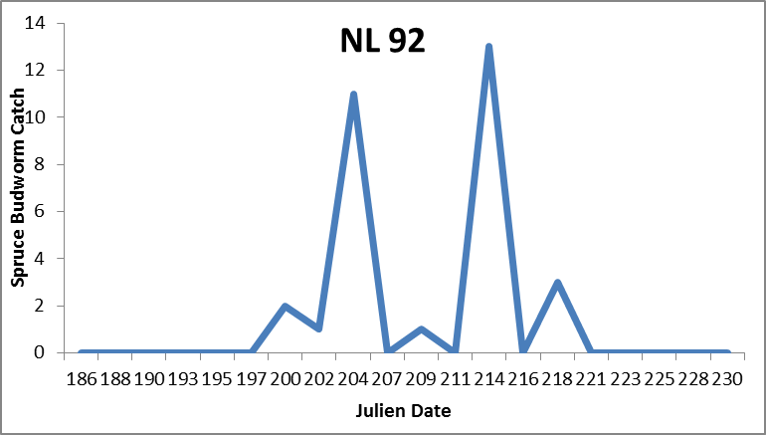
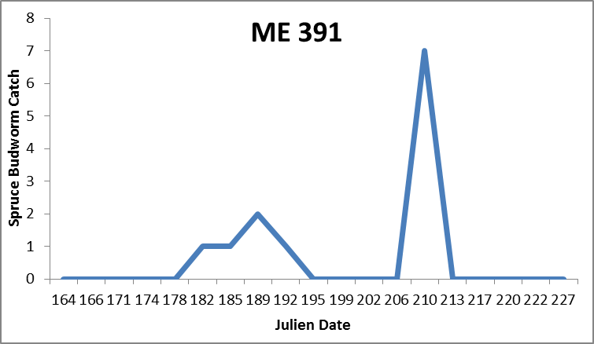



Notes:
Efficacy evidence (for 2015 only). Represented as the % change in L2 density from one season to the next following treatment. The data used here is from plots in the buffers and surrounding areas (within~5km of the treatment area) vs. plots within the treated areas.

Slide 29


Slide 30
Mass
dispersal

Slide 31
Mass
dispersal

Slide 32


  Non-target effects: Moth larvae and enemies
Eveleigh et al. (2007) PNAS

Slide 33


  Non-target Impacts: Broader ecosystem

Slide 34
Early Intervention Strategy
Criteria for feasibility:
  Population dynamics
  Monitoring: Detection at low densities
  Efficacy and non-target effects
  Communication and outreach
  Benefits > costs

Slide 35








Notes:
Website and Citizen Science approach to outreach and communication.

Slide 36


Slide 37




DDT - 1962
Fenitrothion - 1982
Notes:
Against DDT

Slide 38


What is Btk?
Protein crystal
Soil bacteria
Spore

Slide 39
How does Btk work?

Slide 40
How does Btk work?

Slide 41
How does Btk work?

Slide 42
How does Btk work?

Slide 43
How does Btk work?

Slide 44
How does Btk work?

Slide 45
How does Btk work?

Slide 46








How does Btk work?
Acid
Neutral
Base
PH scale

Slide 47














How does Btk work?
Acid
Neutral
Base
Btk breaks down
Btk activates
PH scale

Slide 48
Why we say “Btk is not toxic”
EPA, USDA, WHO:
“Owing to their specific mode of action, Bt products are unlikely to pose any hazard to humans or other vertebrates or to the great majority of non-target invertebrates.”
Registered (and used widely) in Organic farms.
Used in June 2015 in downtown Winnipeg.

Slide 49



Slide 50





Quebec
Charlo River
Eel River
~600 colonies per mL
Freshwater fish
Rodents
Quebec
Charlo River (Reservoir)
Charlo River (River)
Eel River (Upper)
Eel River (Mid)
Eel River (Facility)
Notes:
Freshwater fish and rodent numbers are maximum tested concentrations with no observable effect. Estuarine fish are much higher at 2.9x10^10 CFU/mL concentration tested with no observed effect.

Slide 51



Slide 52



Slide 53

How does Mimic work?
“Mimics” the insect molting hormone

Slide 54




How does Mimic work?

Slide 55



How does Mimic work?

Slide 56


Slide 57



Slide 58
Early Intervention Strategy
Criteria for feasibility:
  Population dynamics
  Monitoring: Detection at low densities
  Efficacy and non-target effects
  Communication and outreach
  Benefits > costs

Slide 59
Conclusions
‘Early Intervention’ and ‘Foliage Protection’ offer tools for the toolbox.
Budworm management infrastructure.
Offers an opportunity to better understand budworm ecology and dynamics in our forests.

Slide 60
How can NB and Maine work together?
Criteria for feasibility:
  Population dynamics
  Monitoring: Detection at low densities
  Efficacy and non-target effects
  Communication and outreach
  Benefits > costs

Slide 61






Questions?
Research
Allyson Heustis (UNB)
Benoit Morin (CFS)
Clare Forbes (FPL)
Drew Carleton (FPL)
Emily Owens (FPL)
Eric Moise (CFS)
Holly Blaquière (FPL)
Joel Bates (FPL)
Joris Wiersinga (FPL)
Mallory MacDonnell
DNR New Brunswick, Newfoundland, Nova Scotia, Maine Forest Service

