Slide 1
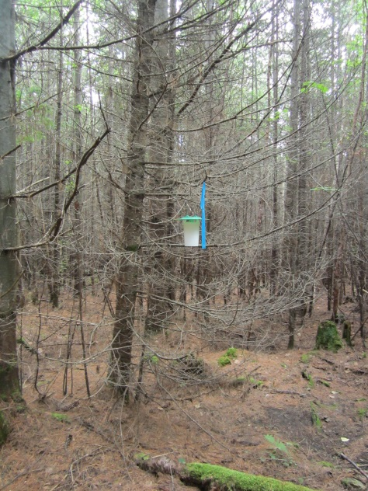
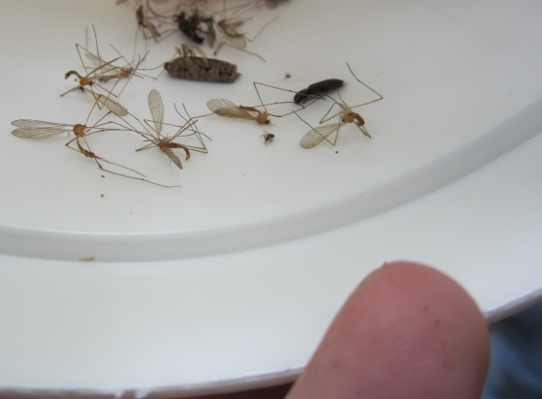
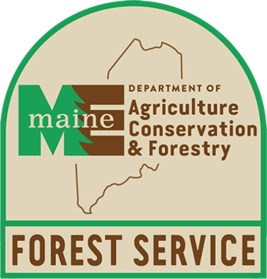
Update on Spruce Budworm in Maine & Preliminary Maine SBW Pheromone Trapping Results
Results as of 10/18/2016
Presented By
Allison Kanoti

Slide 2
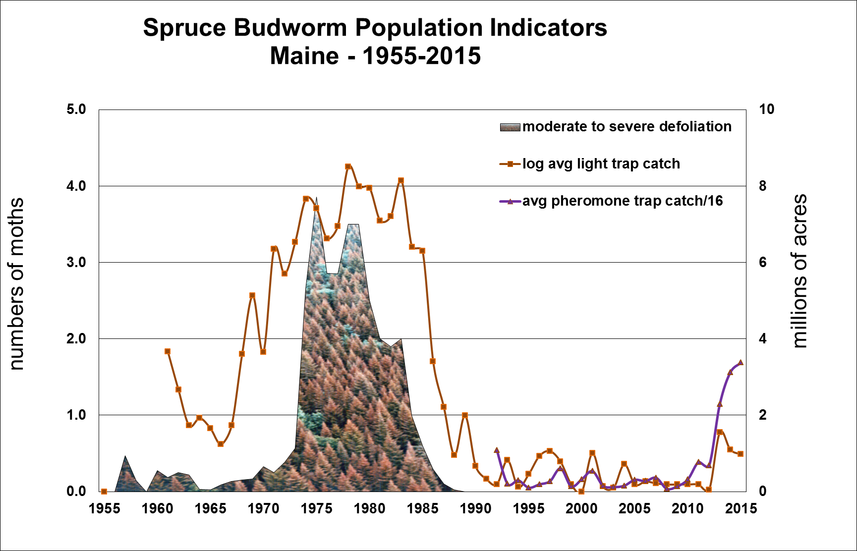
Populations in Maine over Time

Slide 3
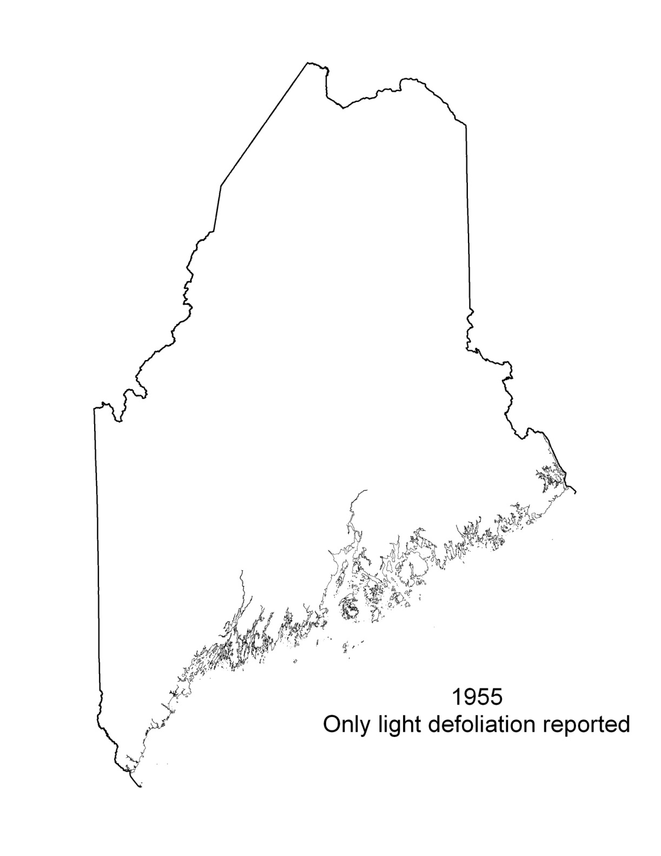
Spruce Budworm Cyclical Populations

Slide 4
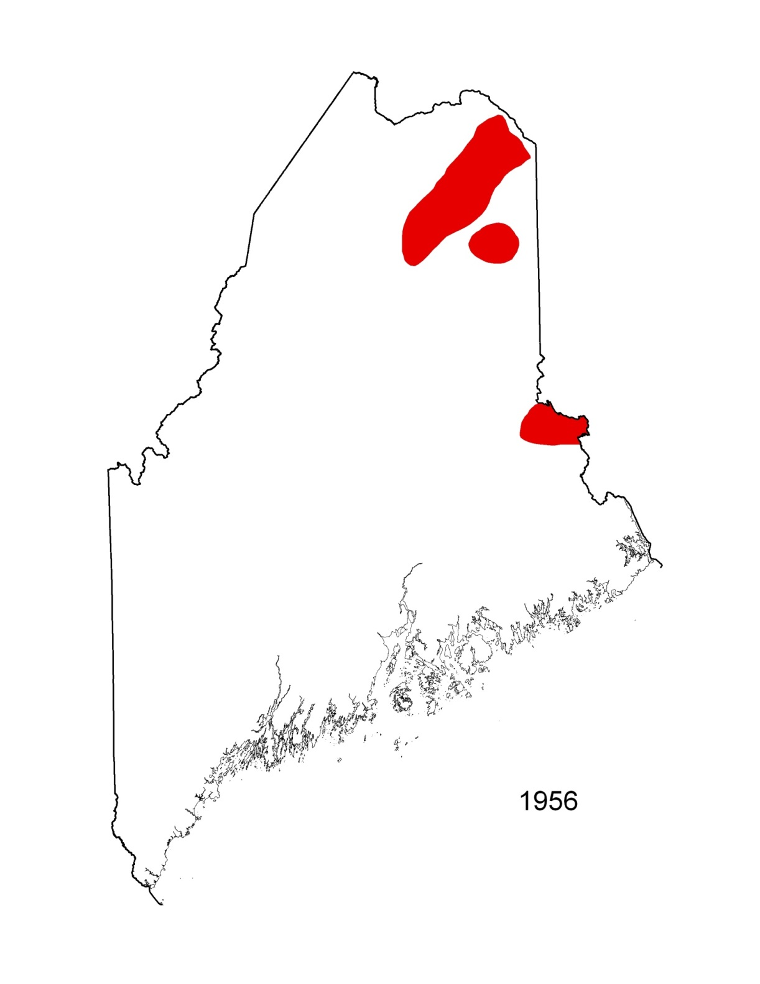

Slide 5
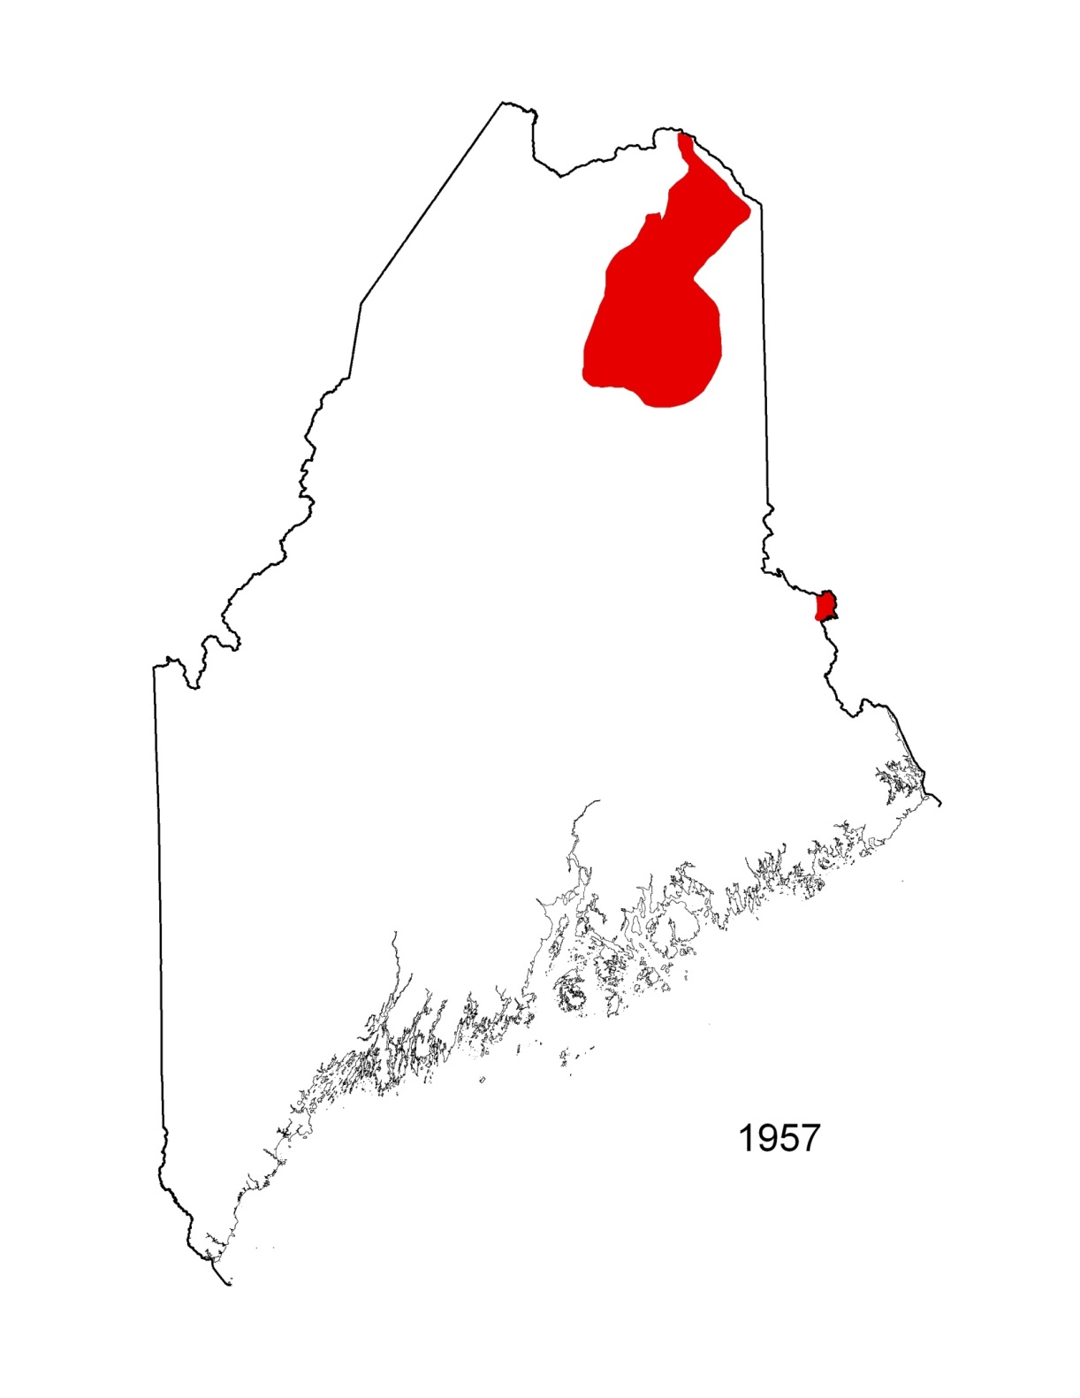

Slide 6
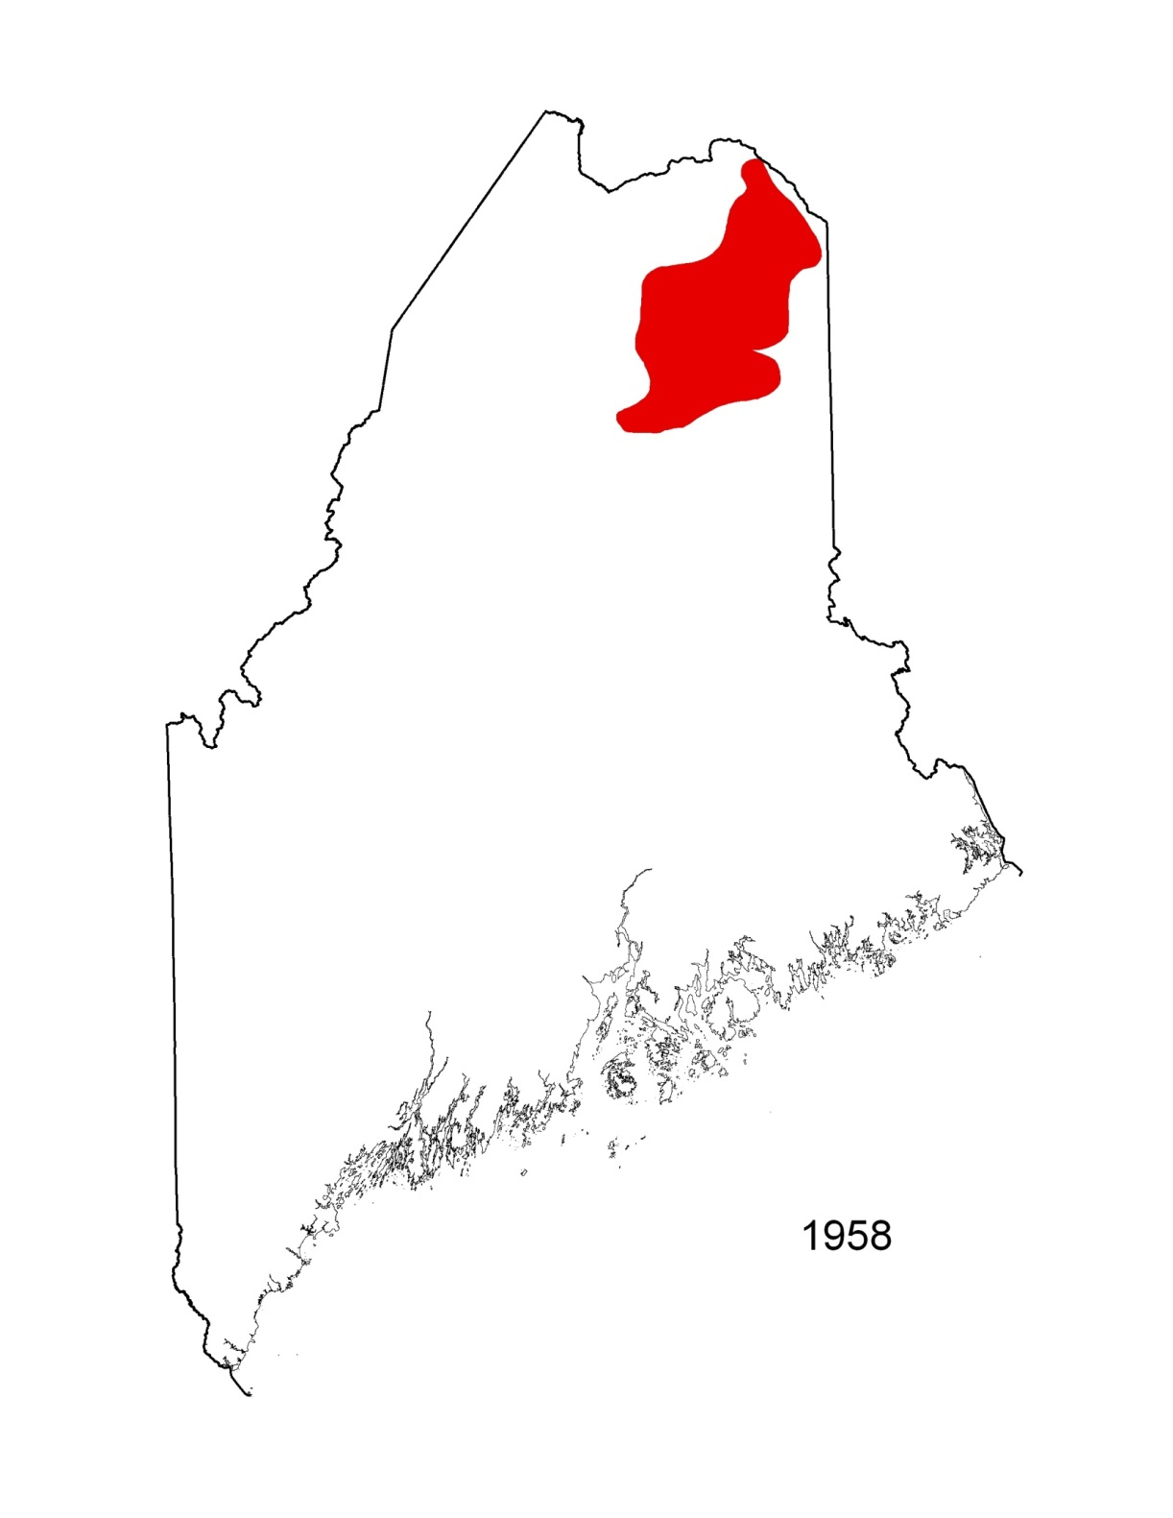

Slide 7
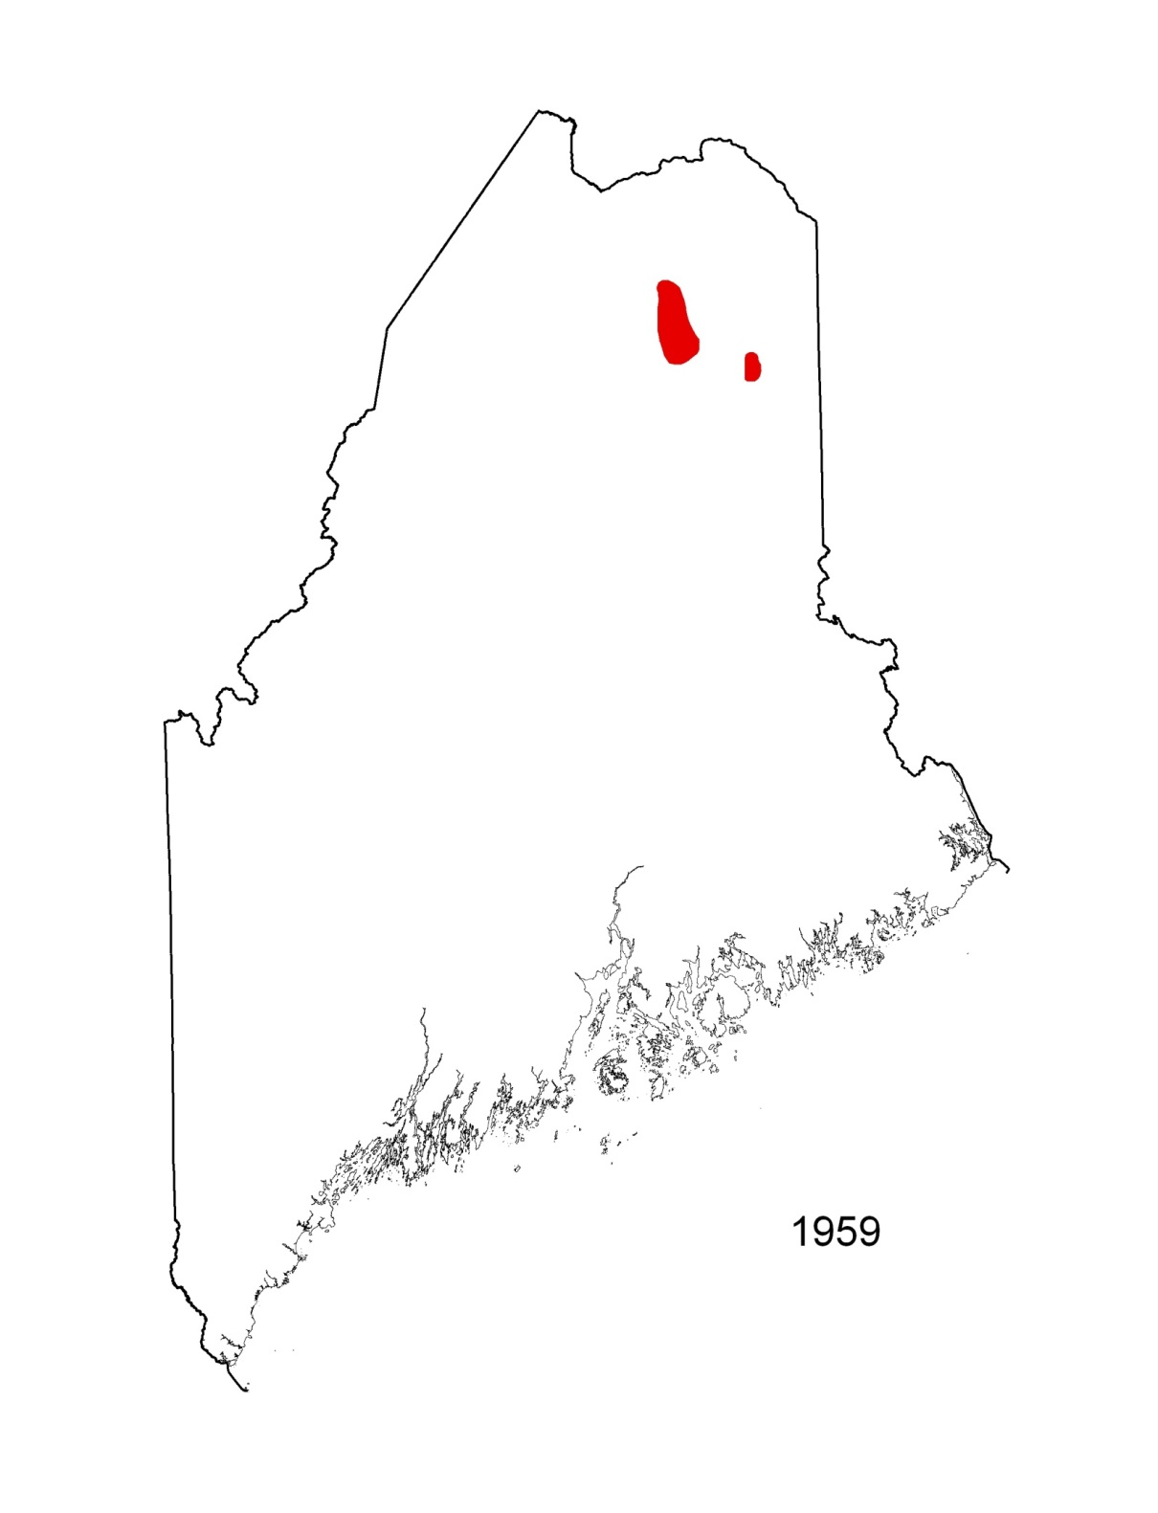

Slide 8
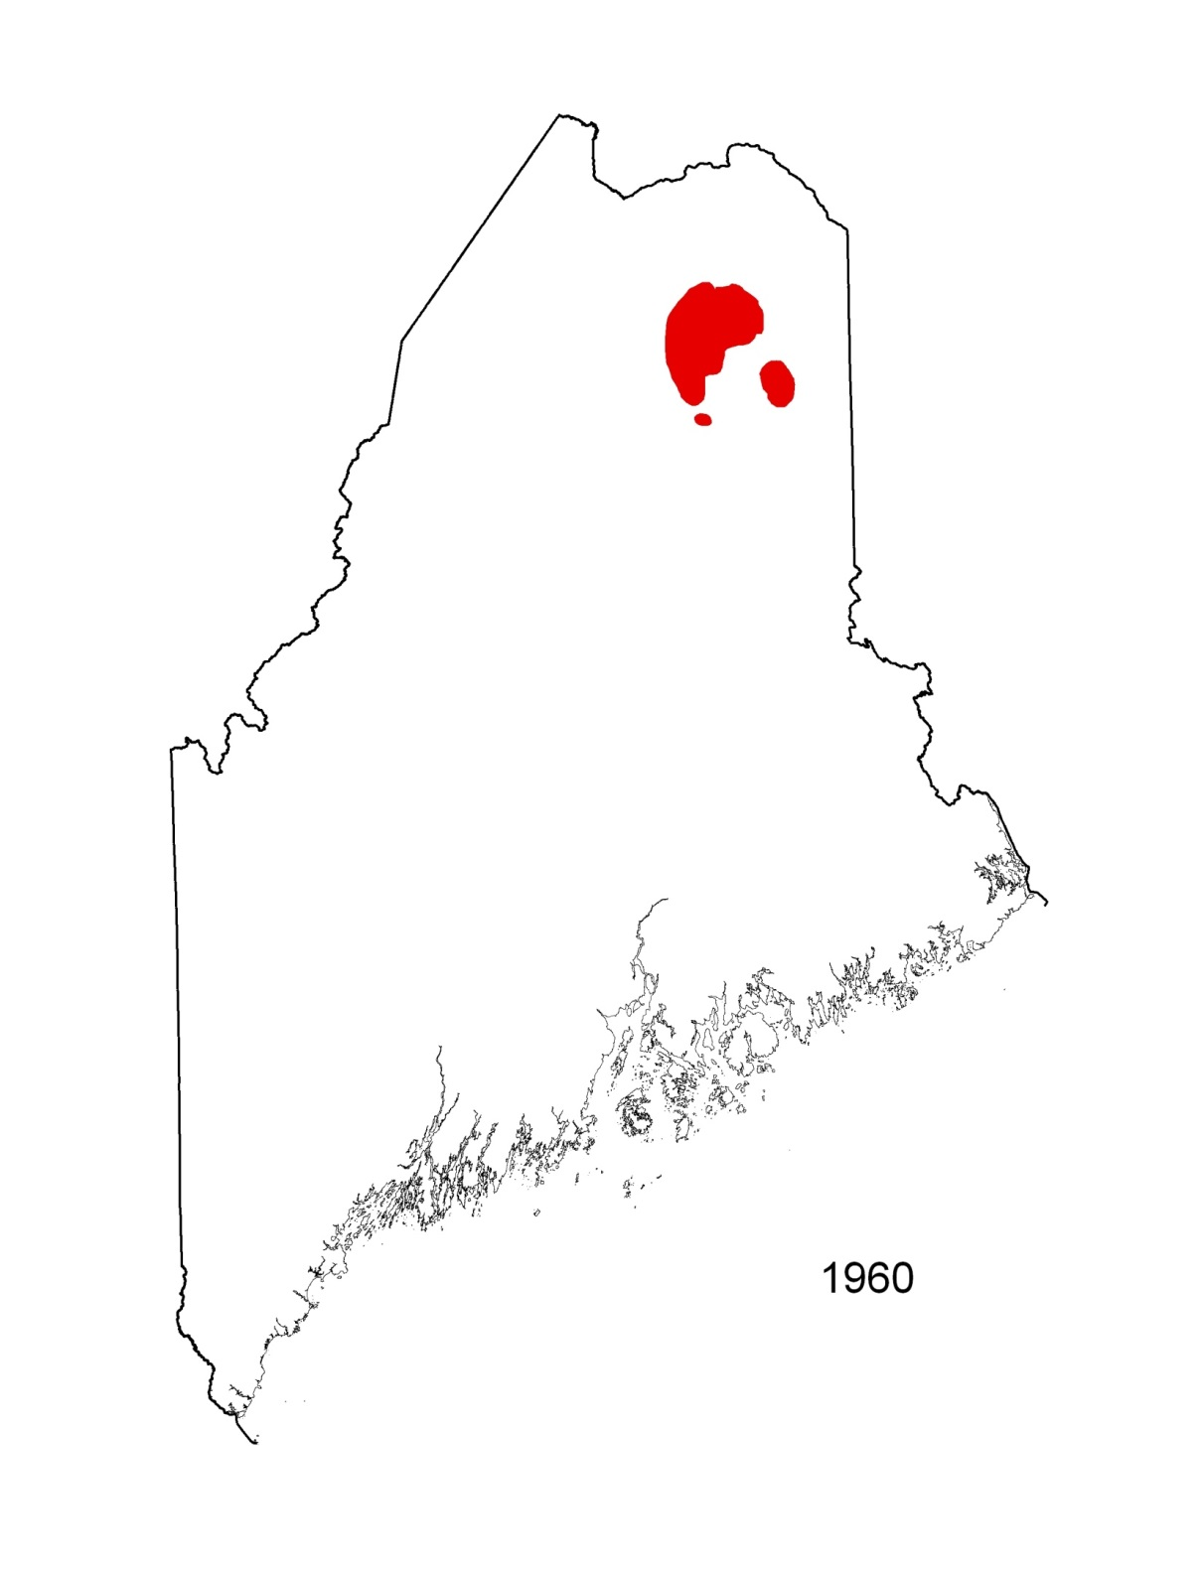

Slide 9
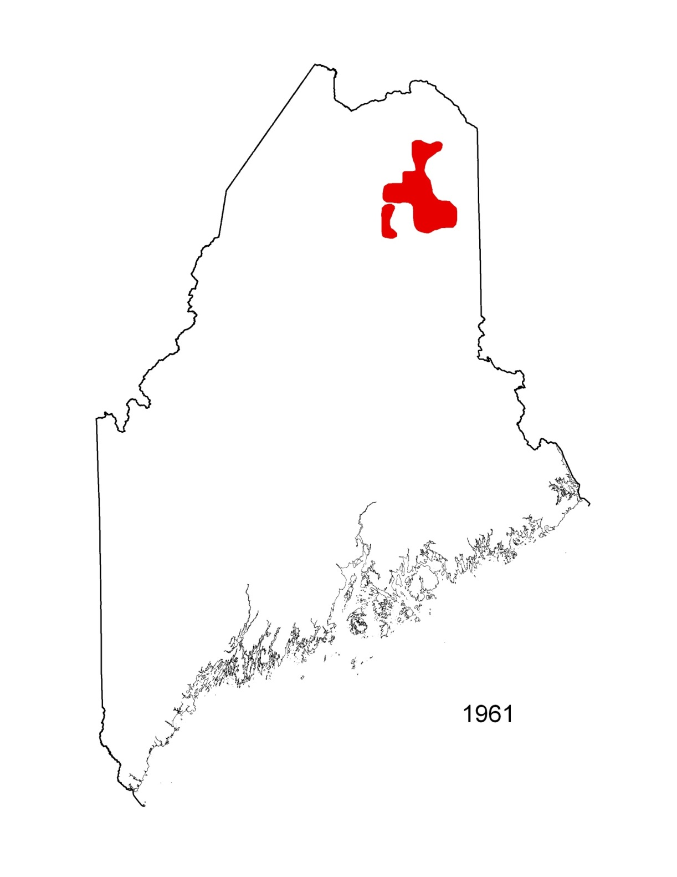

Slide 11
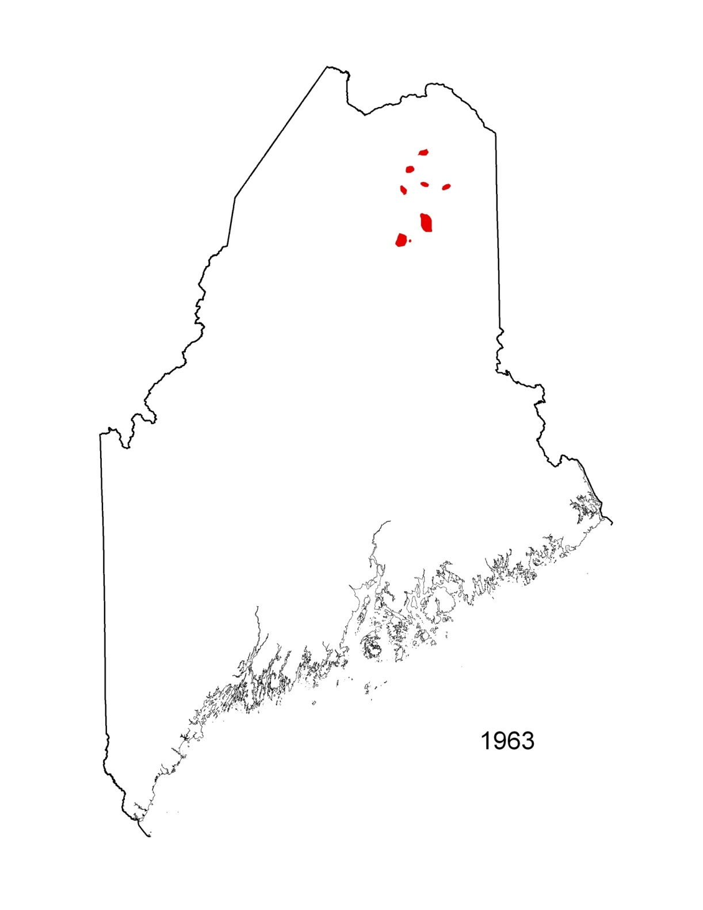

Slide 12
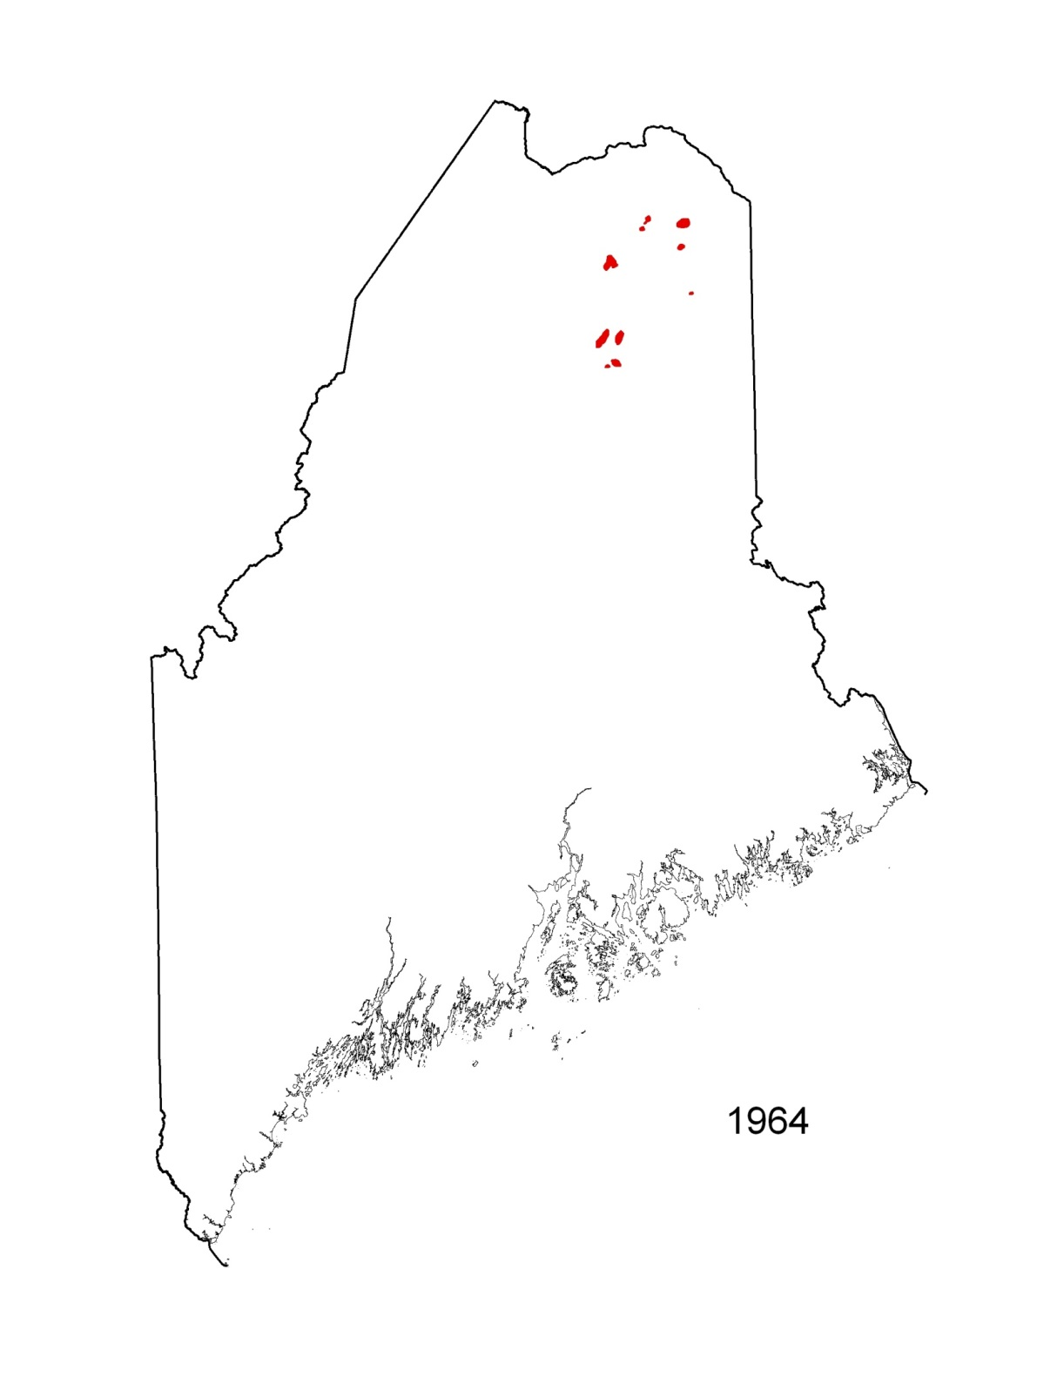

Slide 13
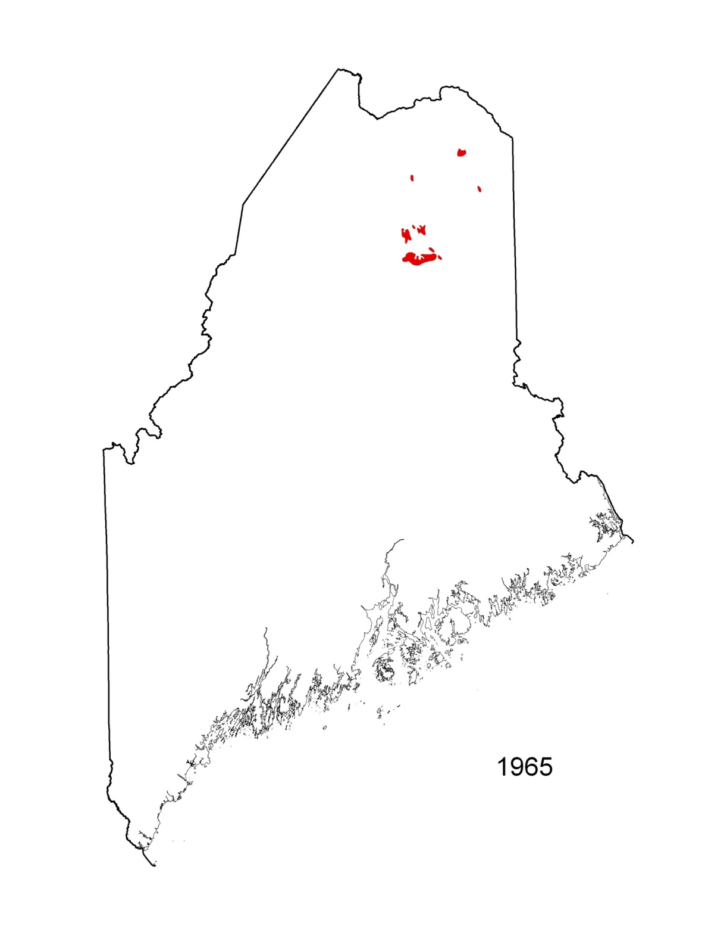

Slide 14
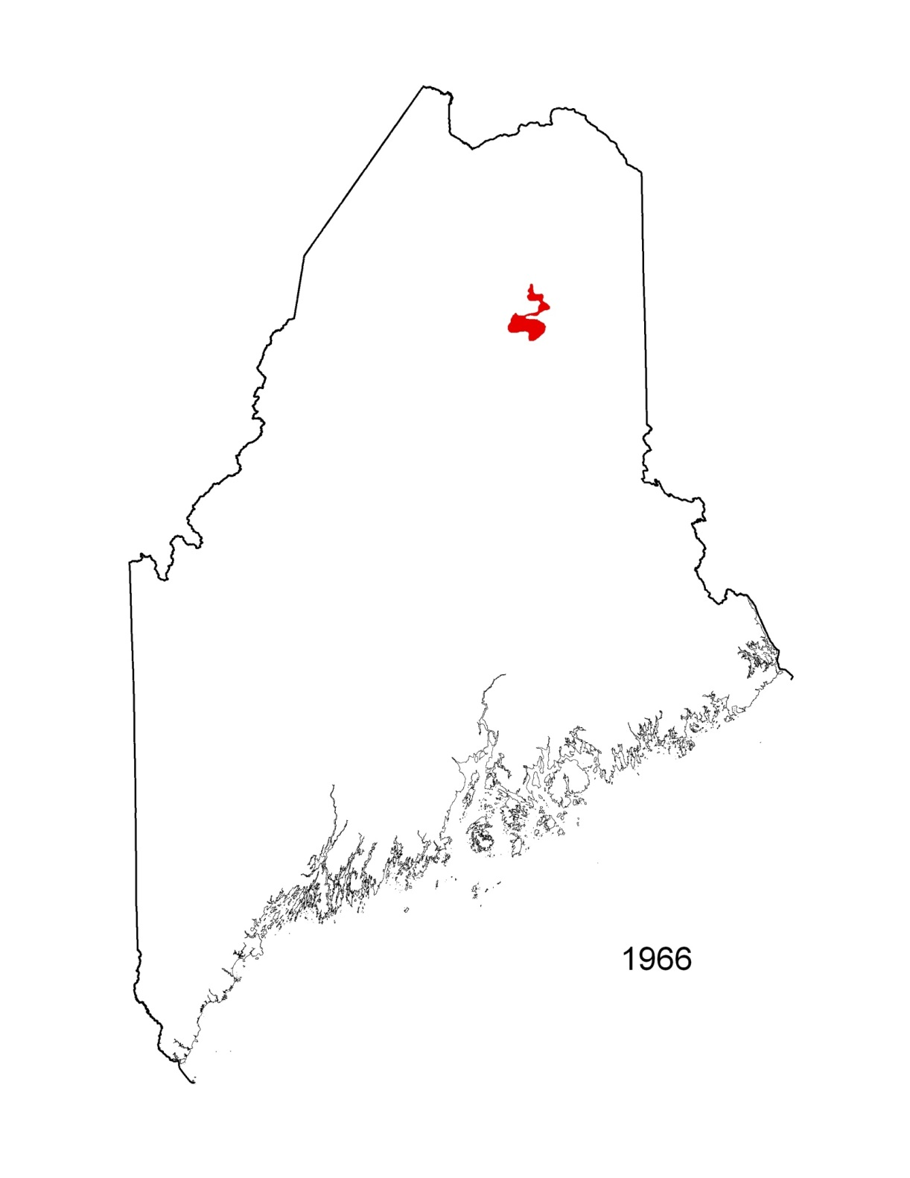

Slide 15
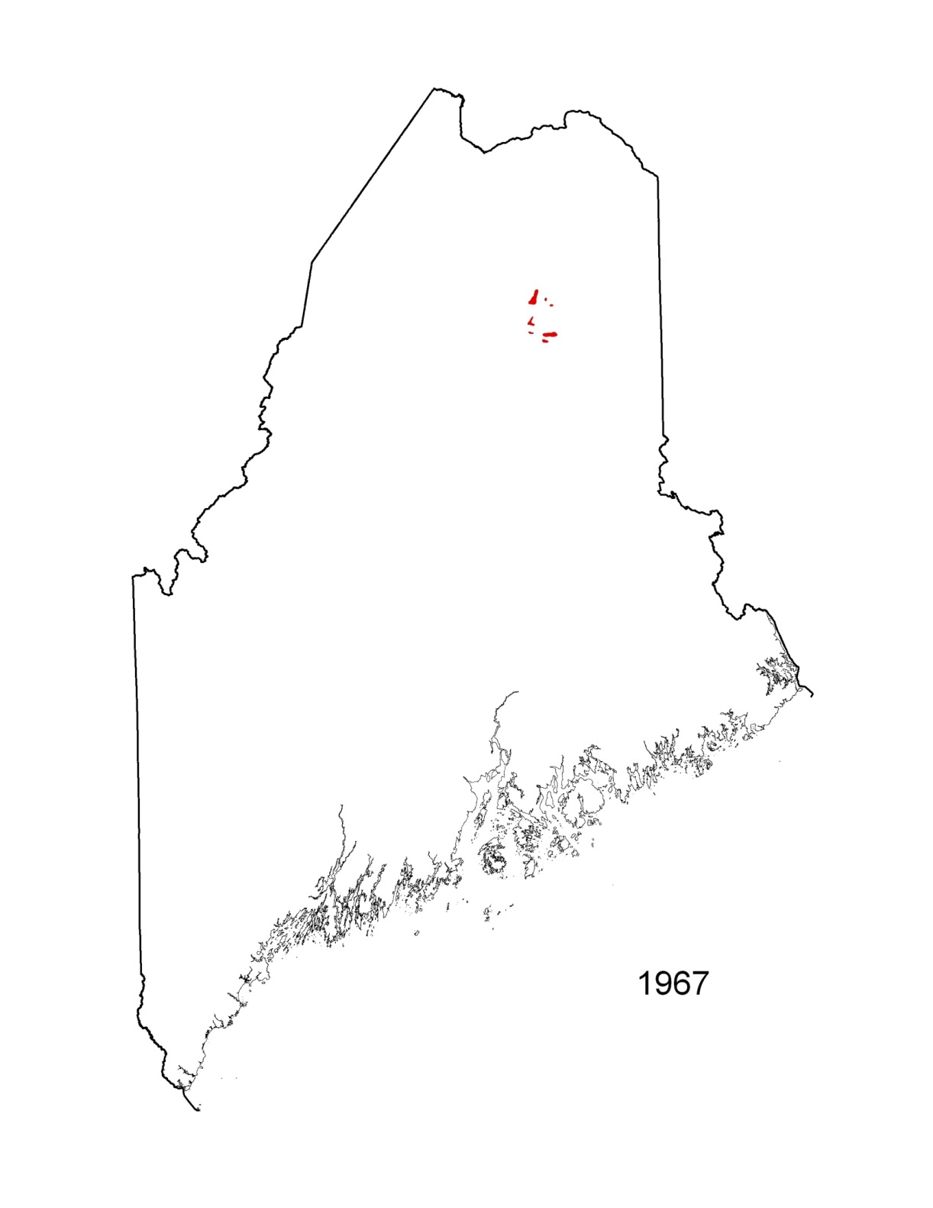

Slide 16
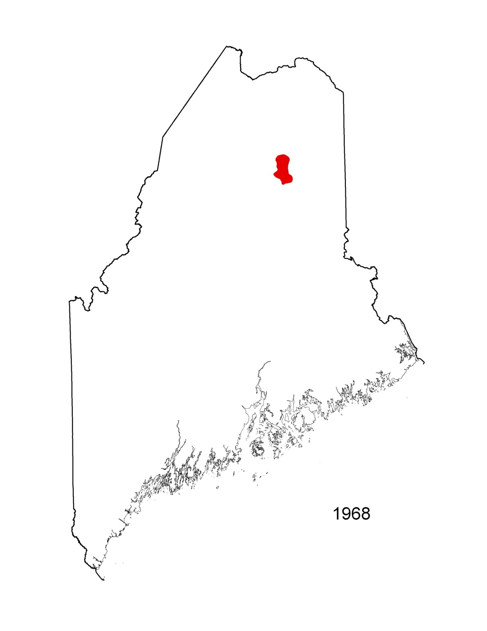

Slide 17
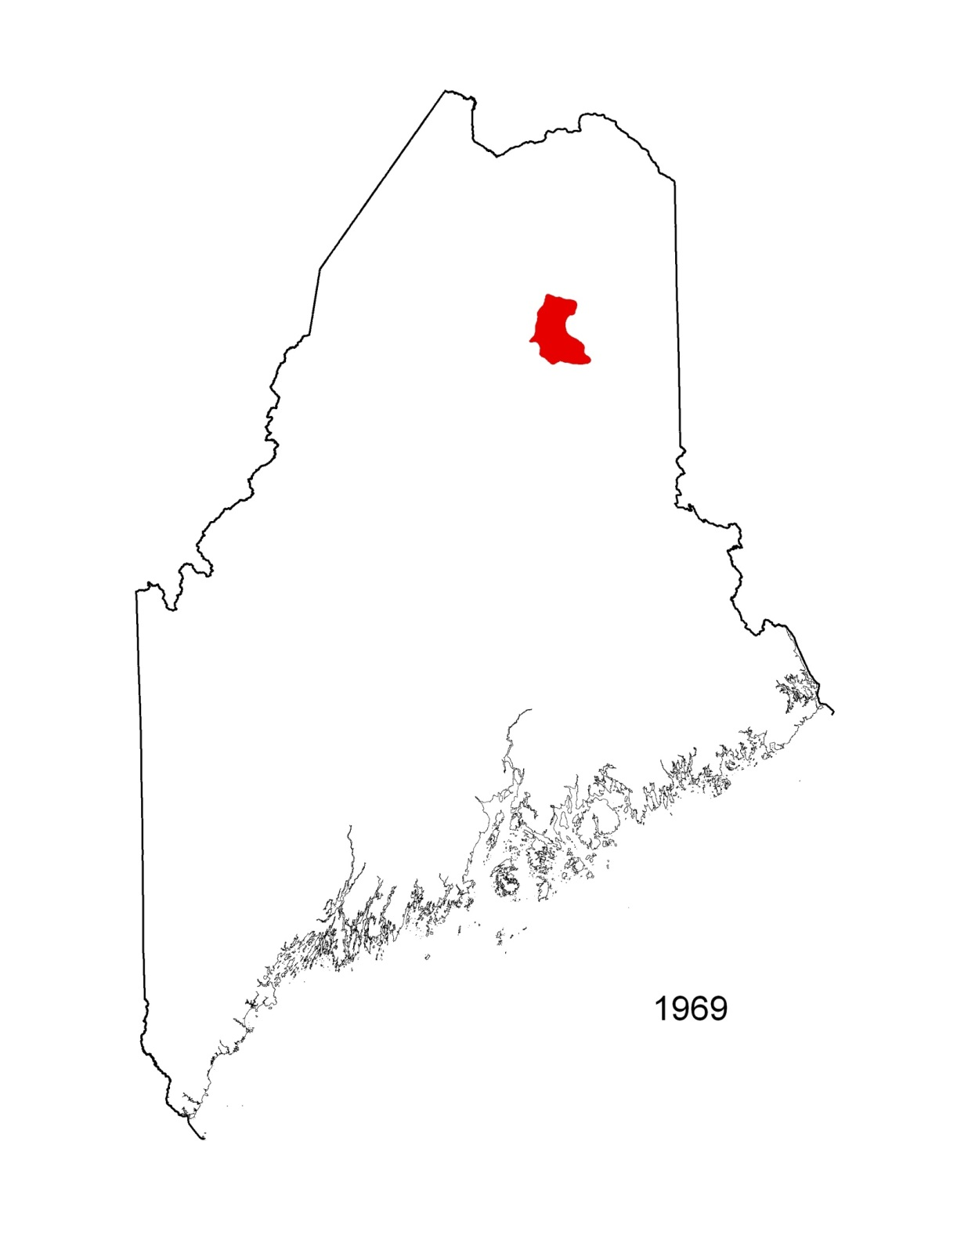

Slide 18
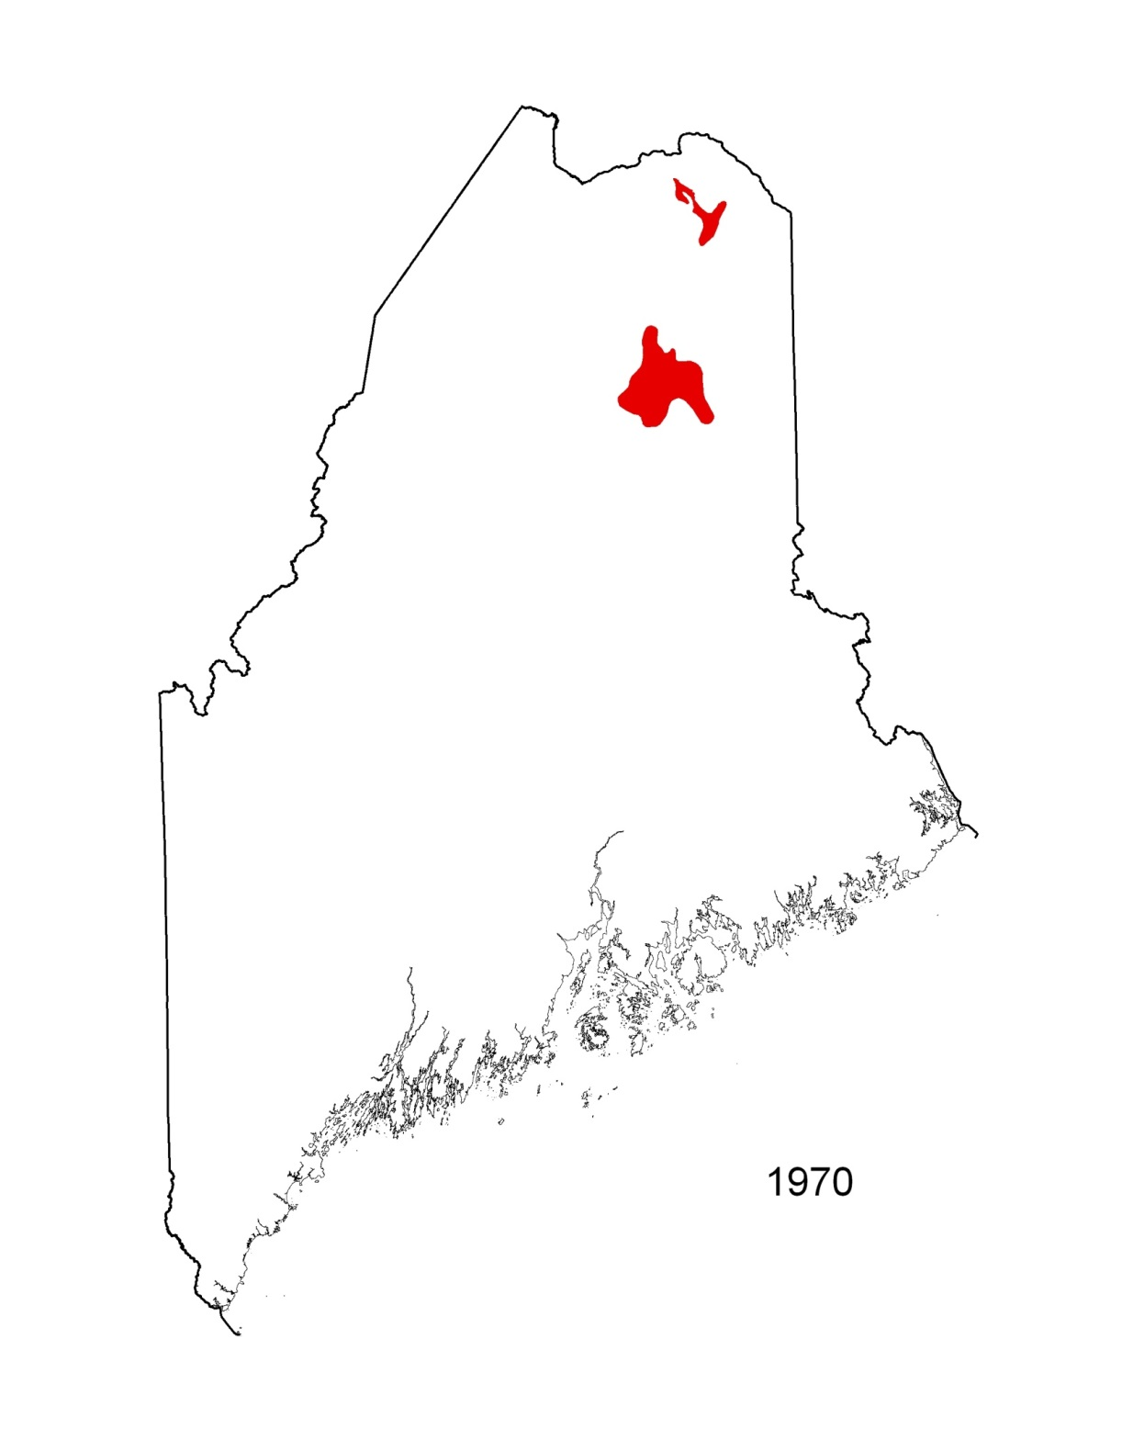

Slide 19
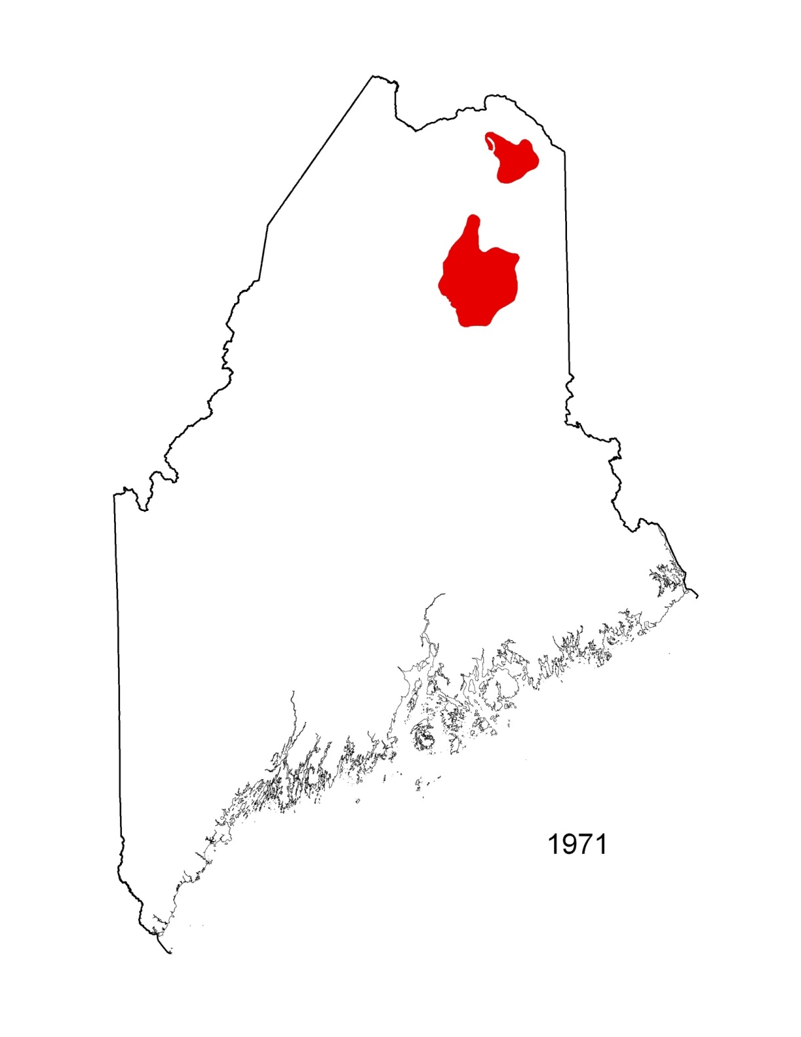

Slide 20
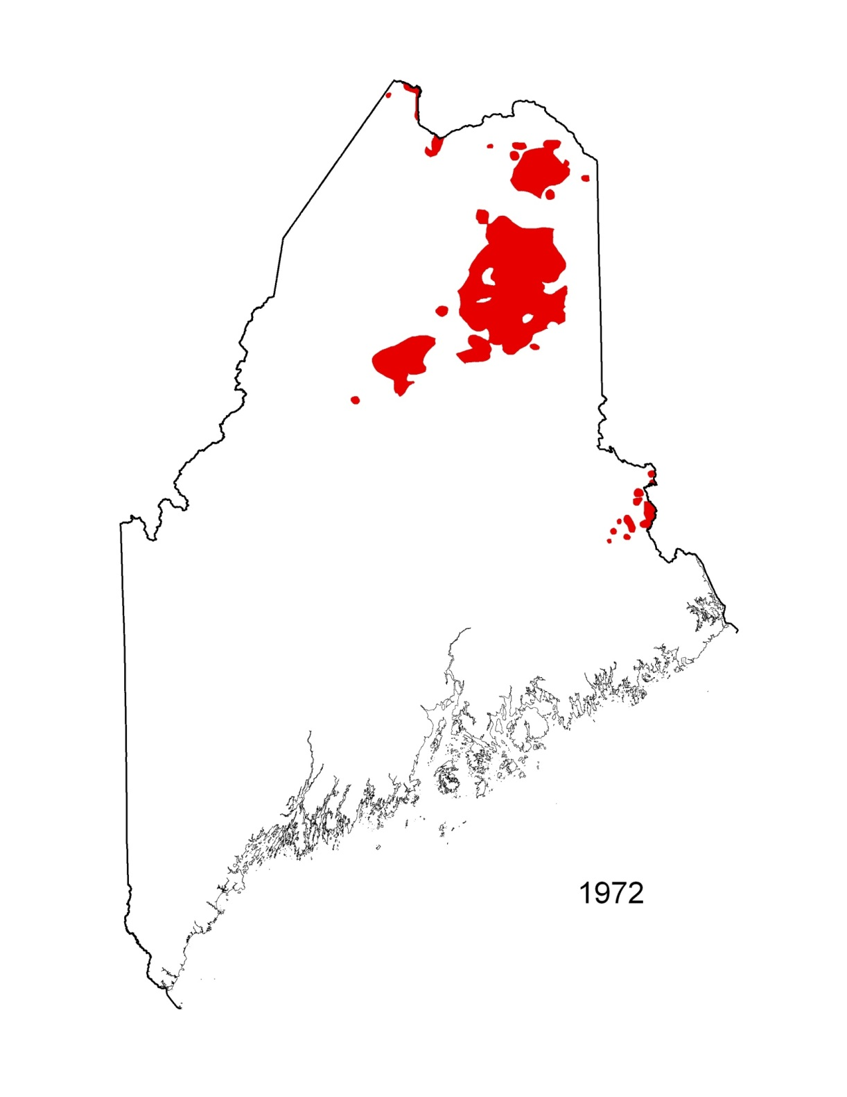

Slide 21
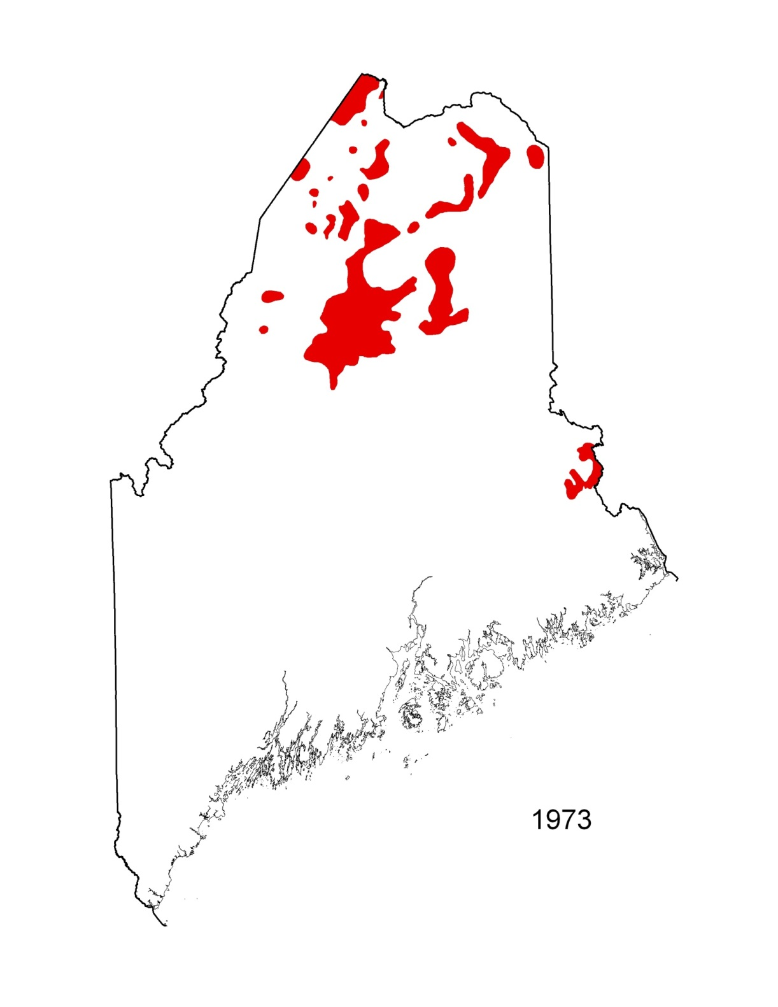

Slide 22
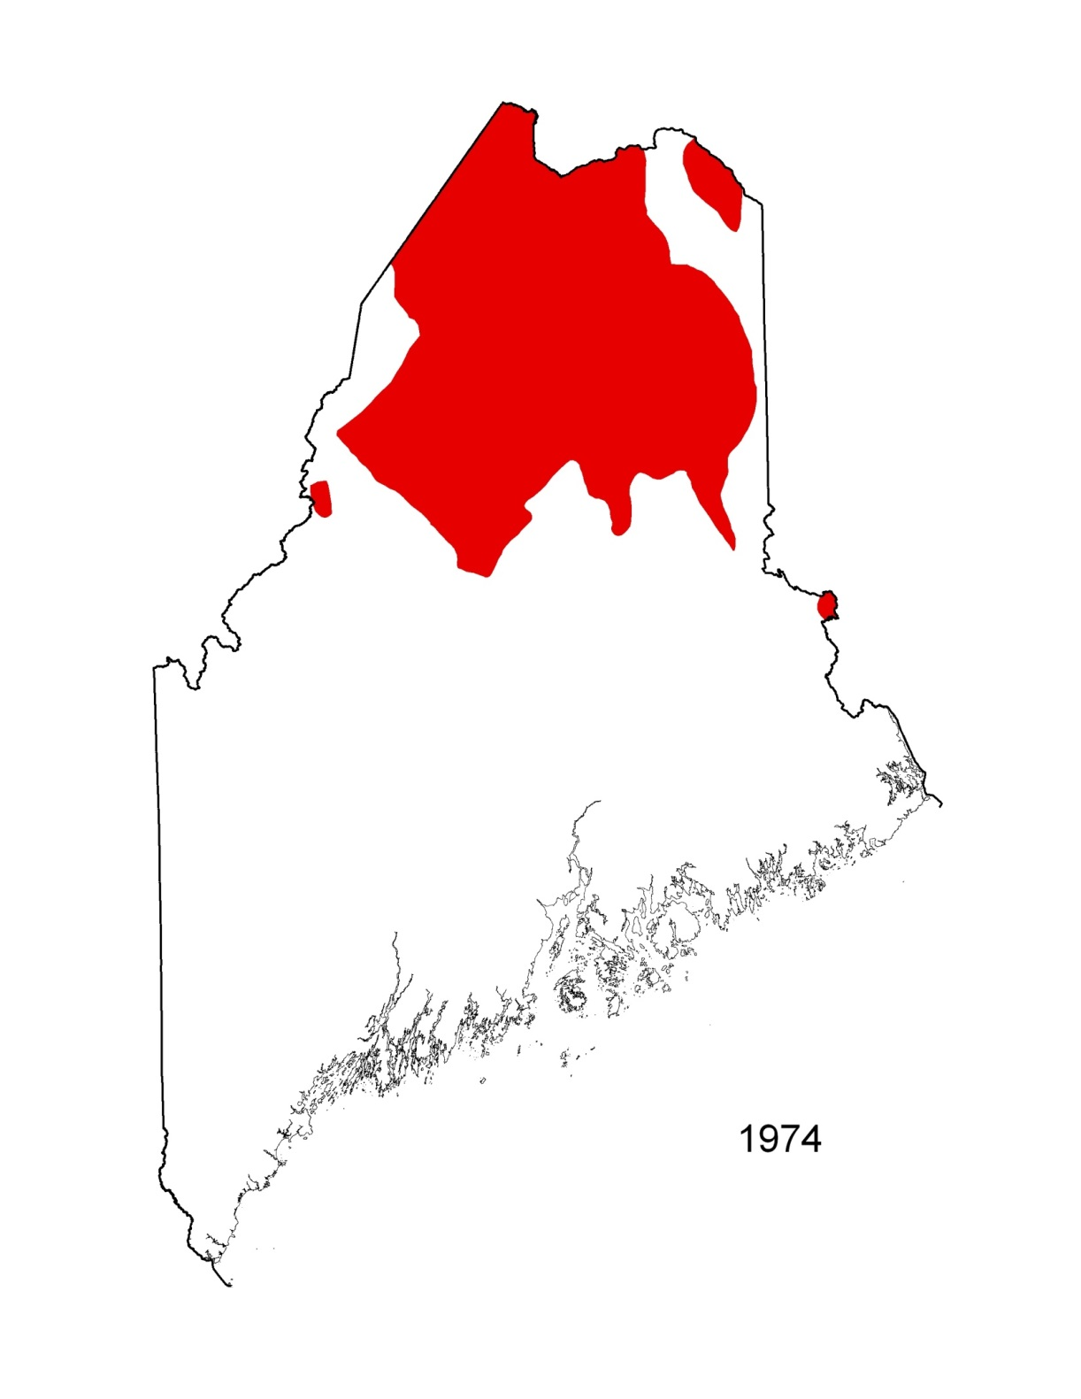

Slide 23
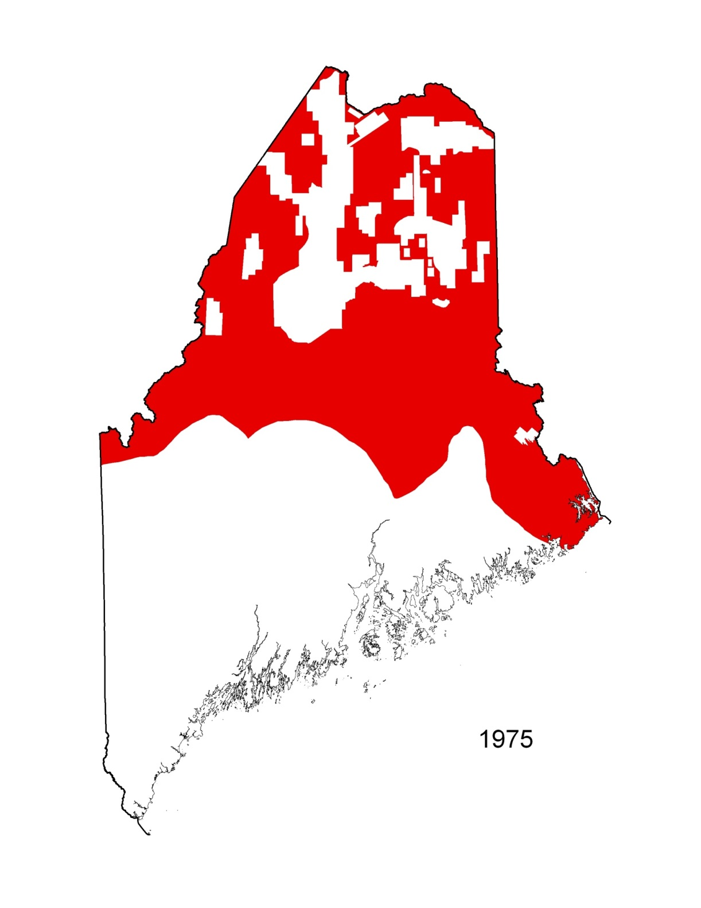

Slide 24
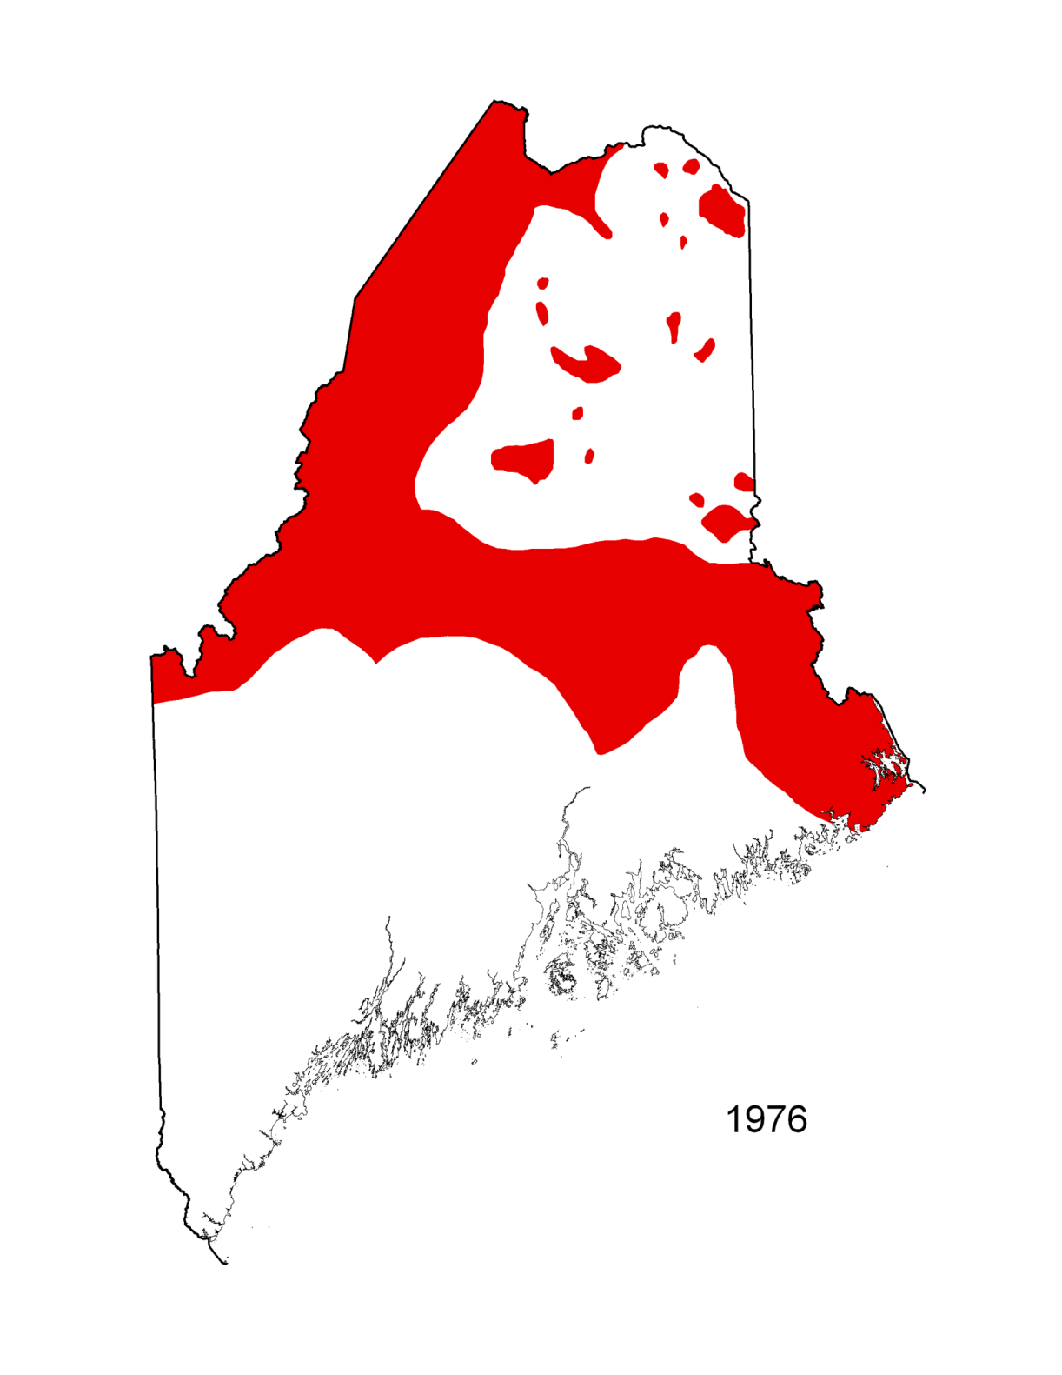

Slide 25
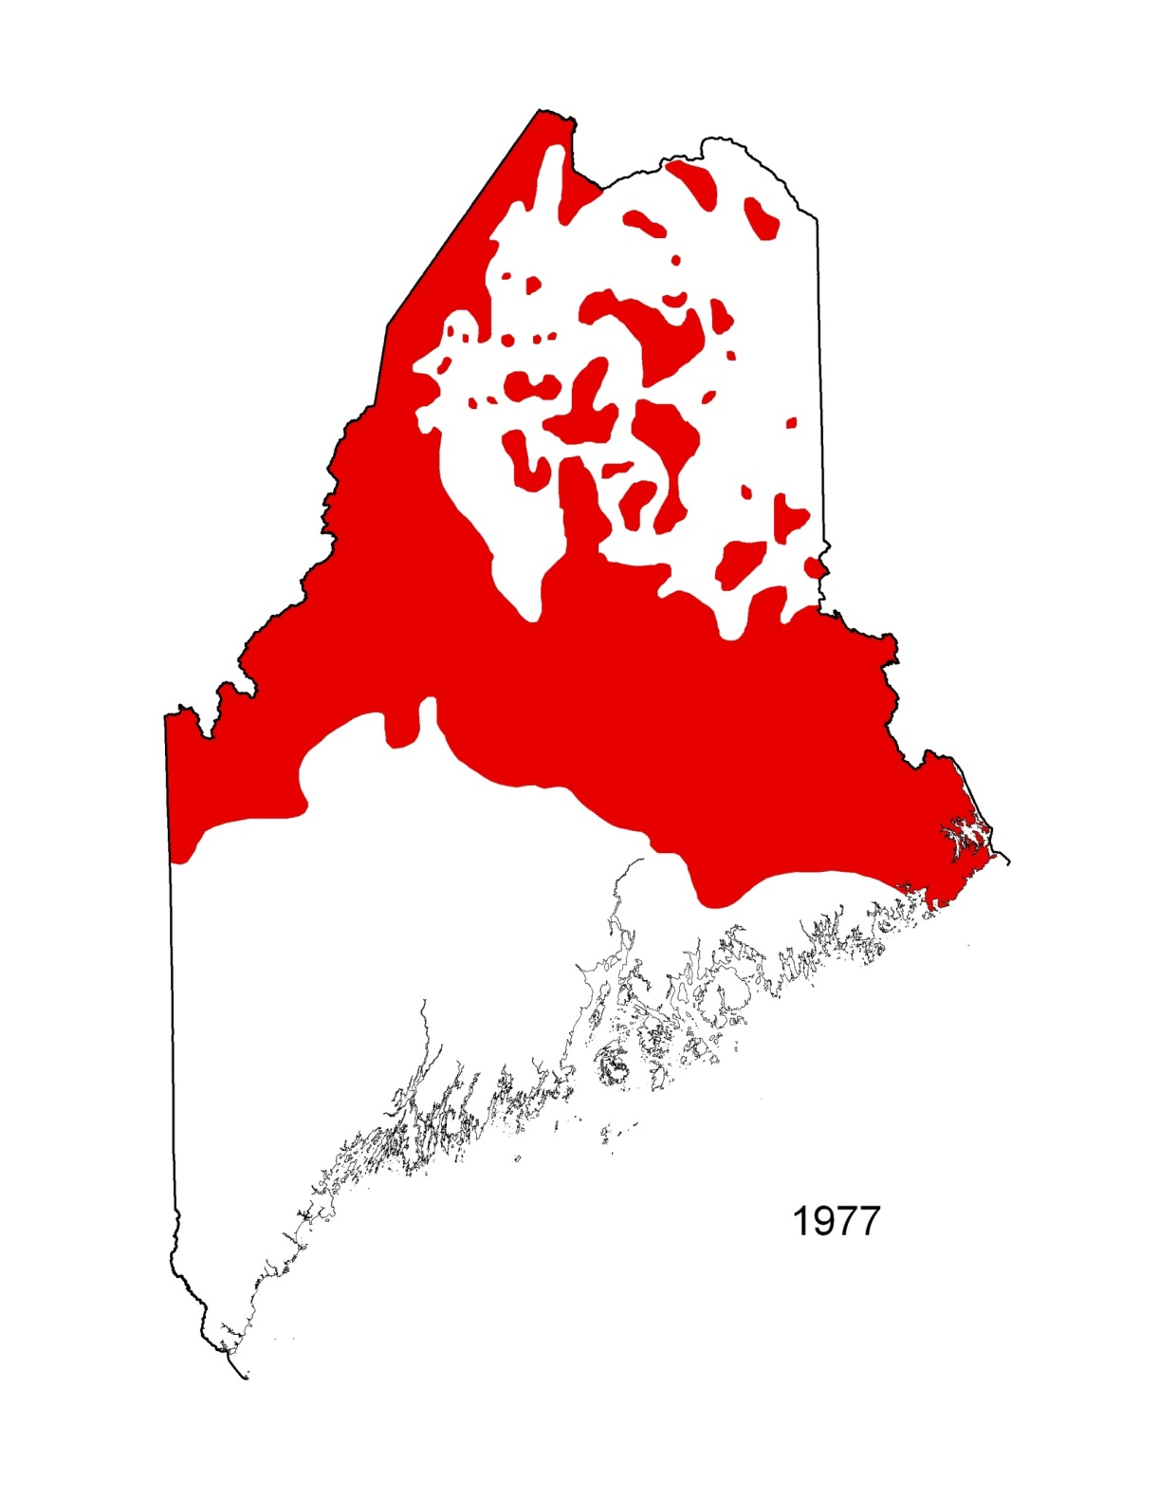

Slide 26
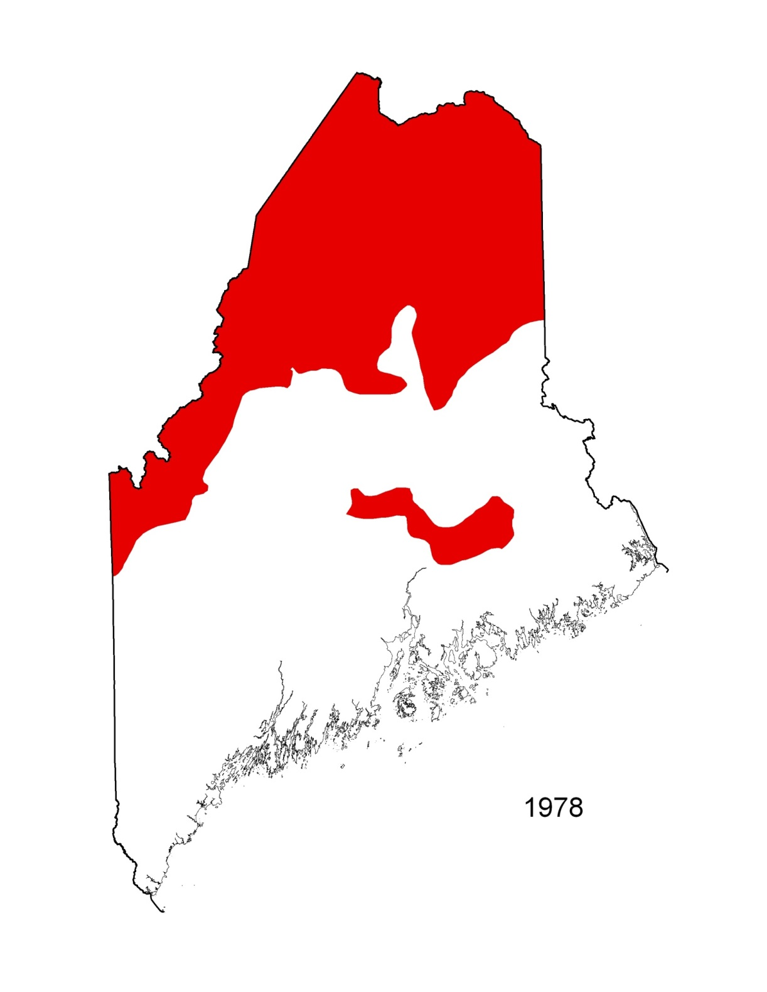

Slide 27
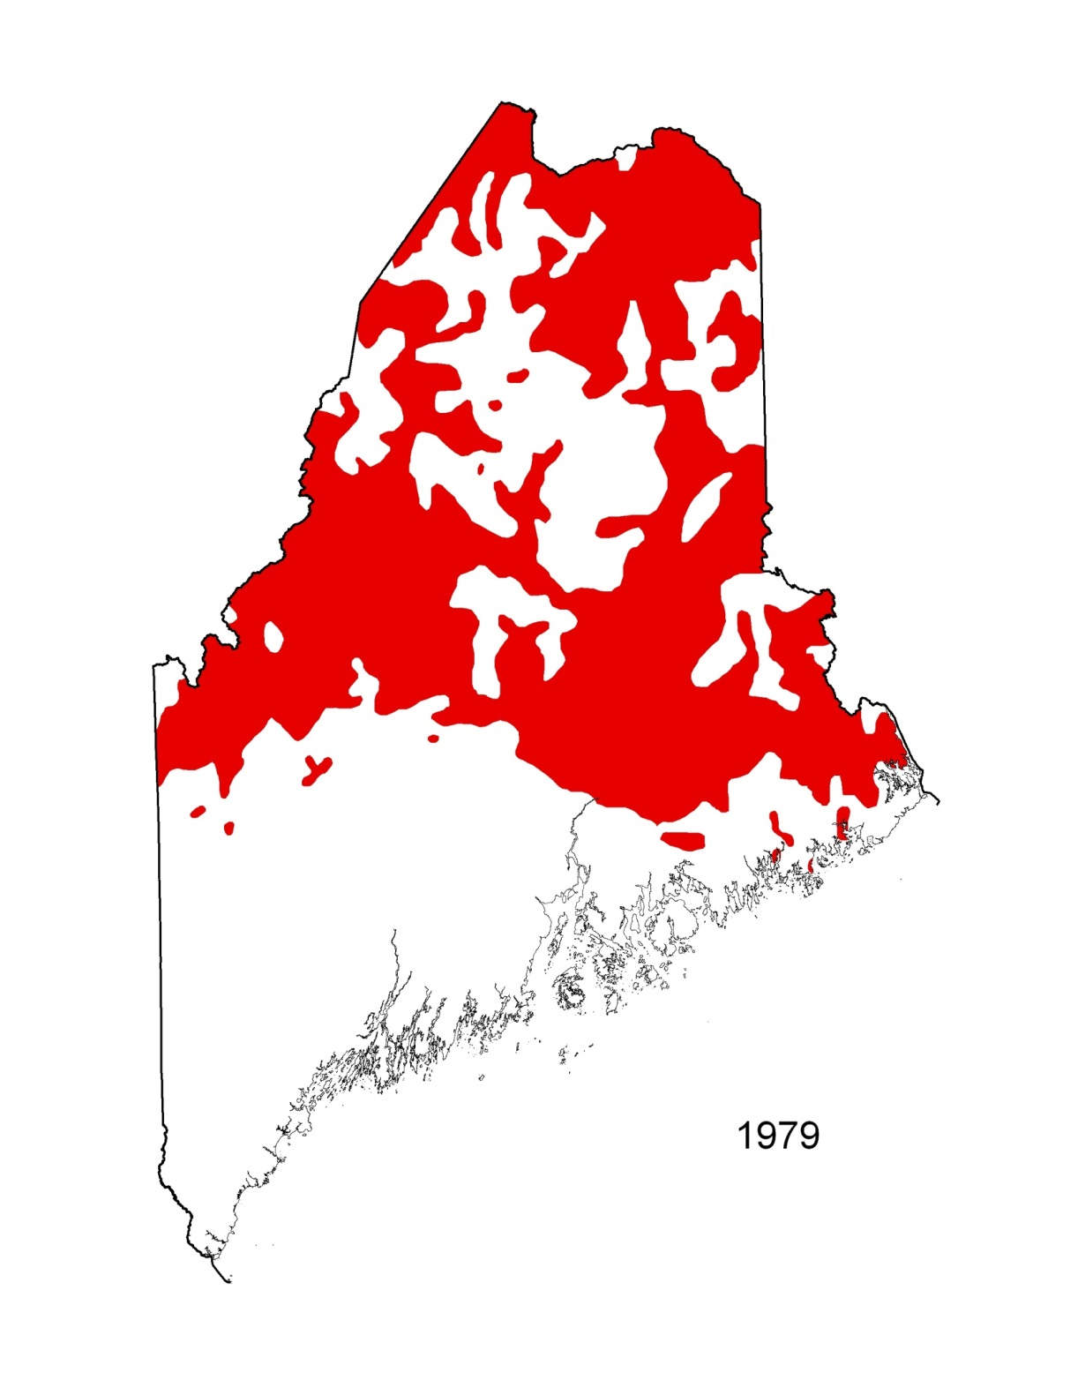

Slide 28
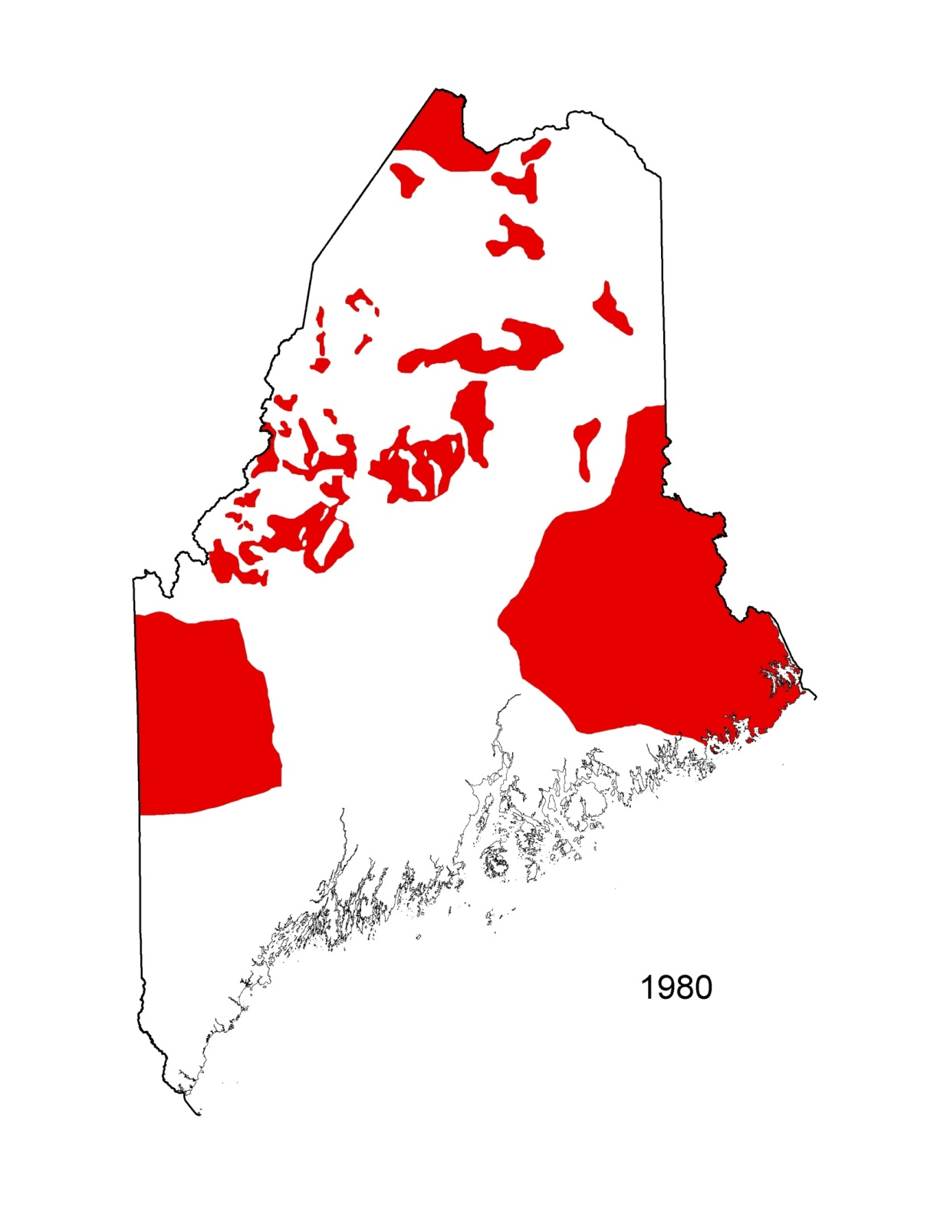

Slide 29
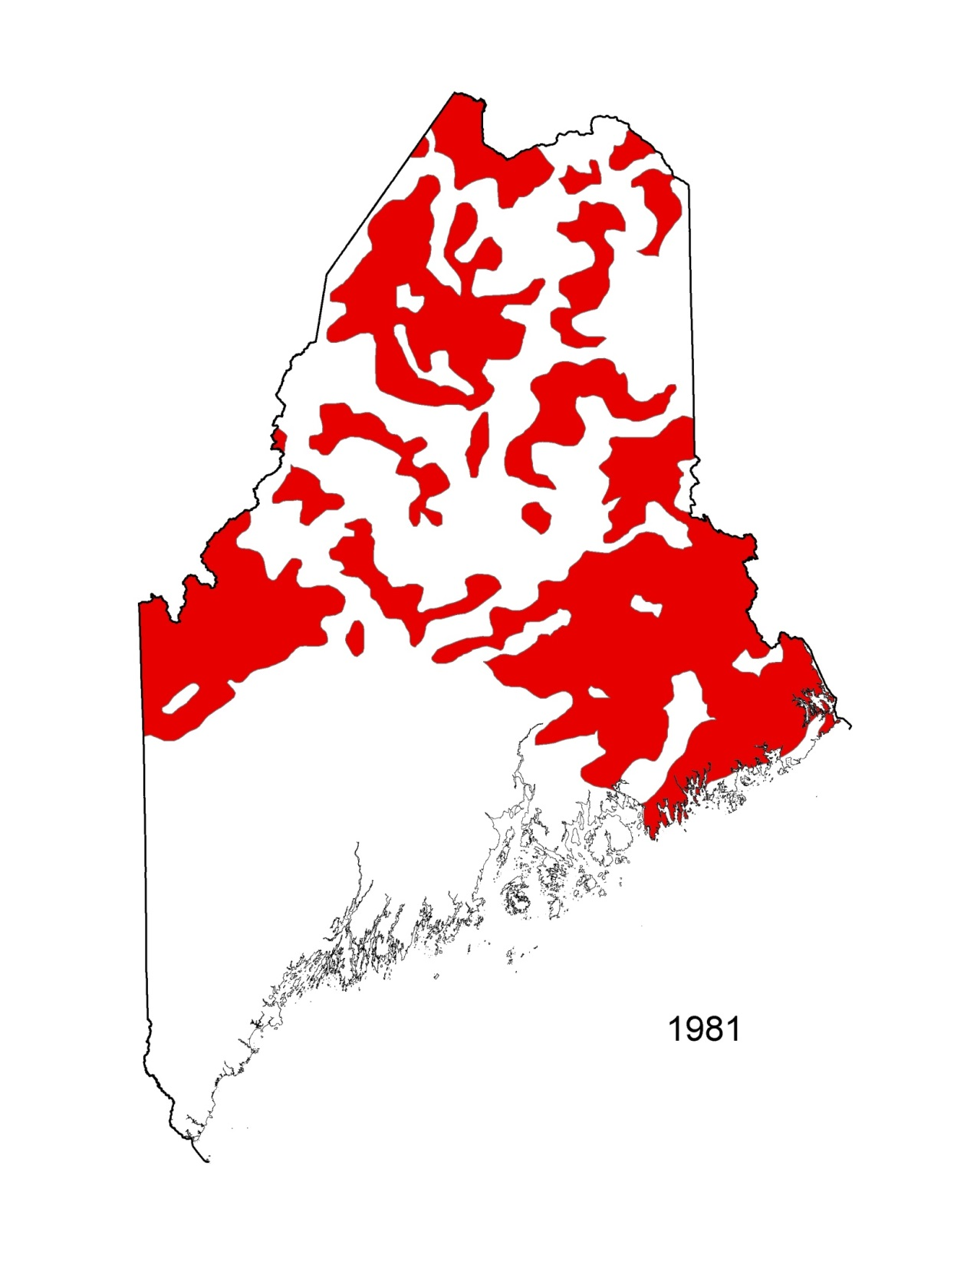

Slide 30
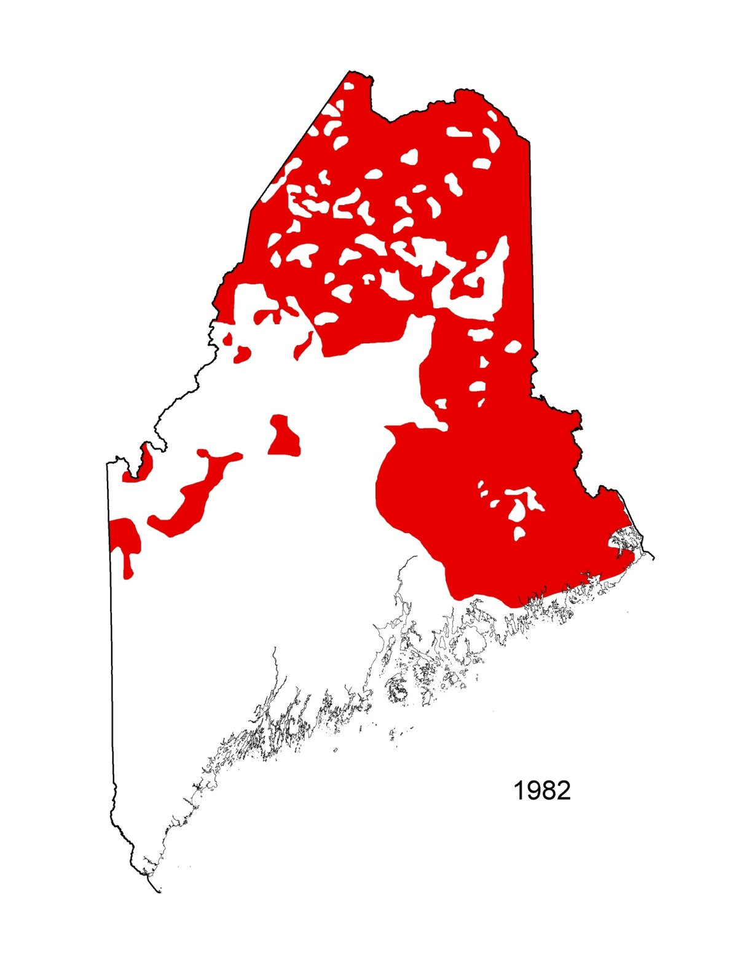

Slide 31
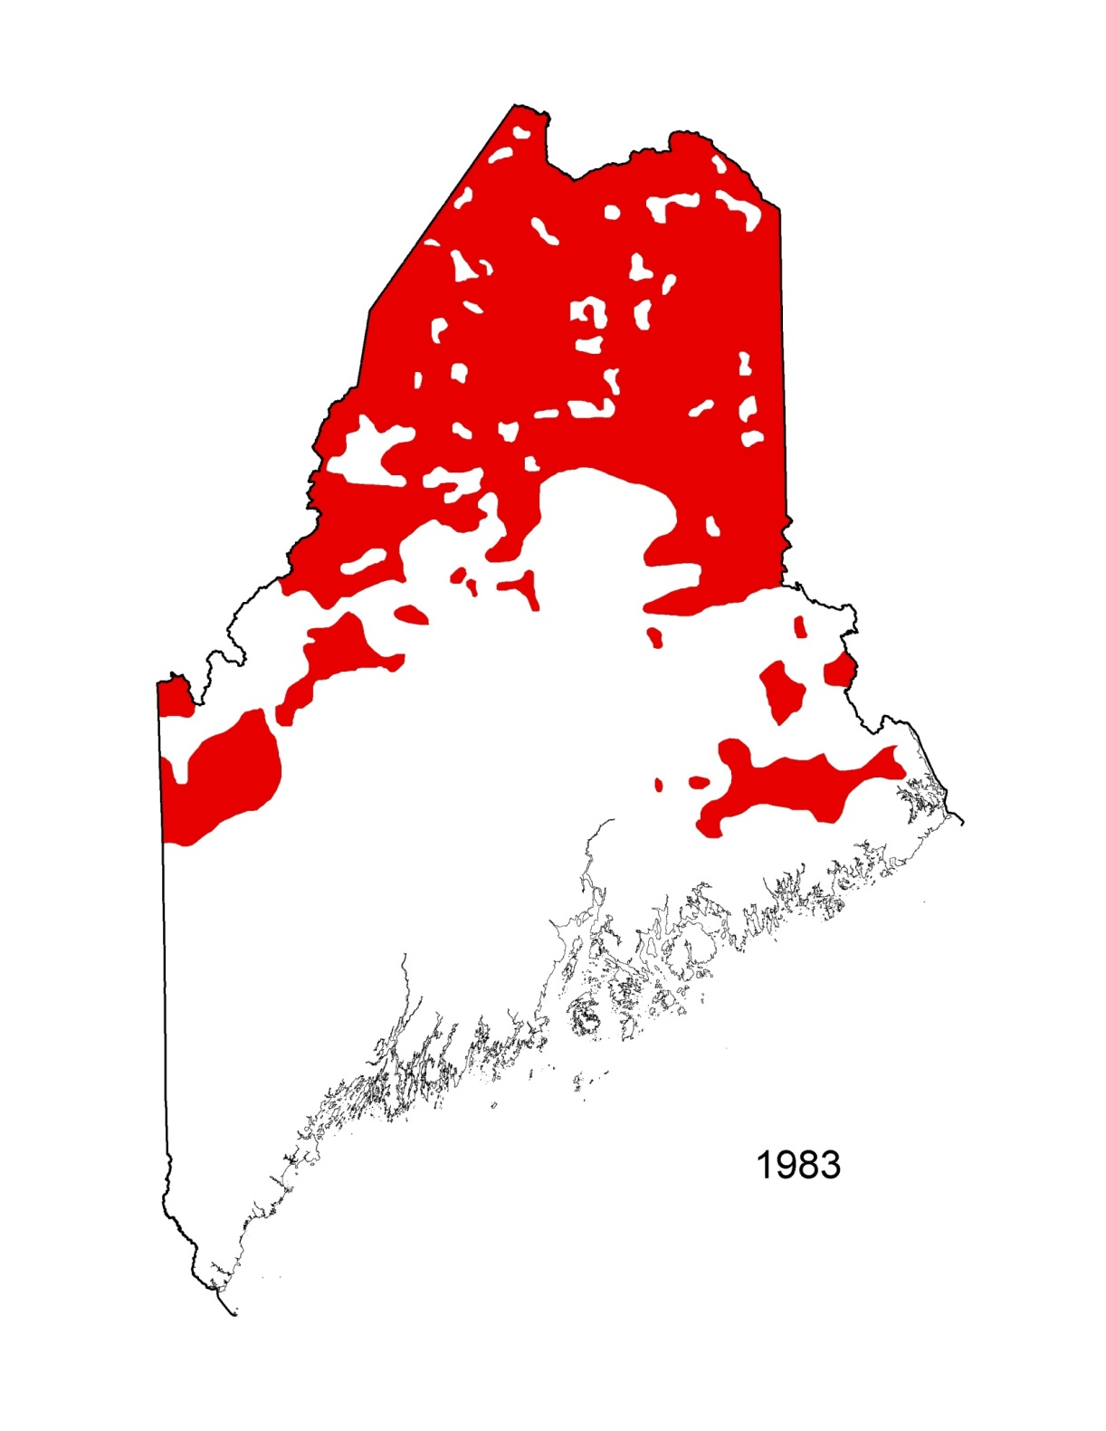

Slide 32
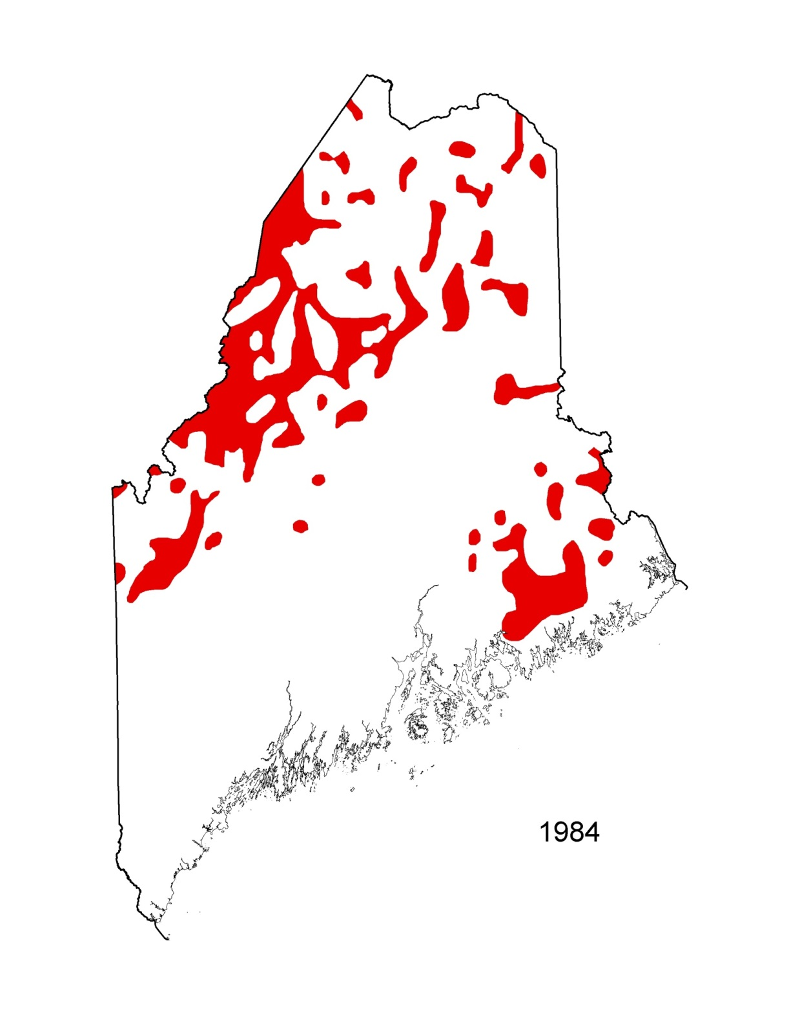

Slide 33
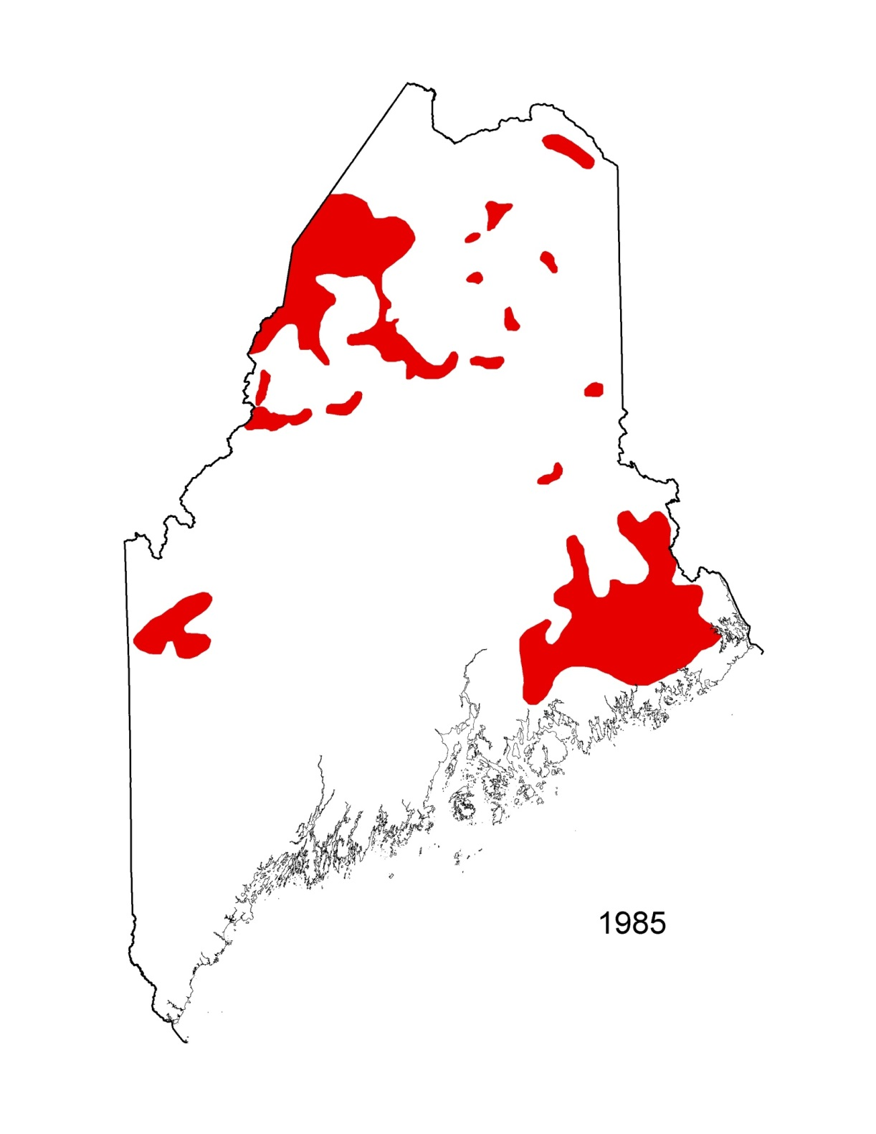

Slide 34
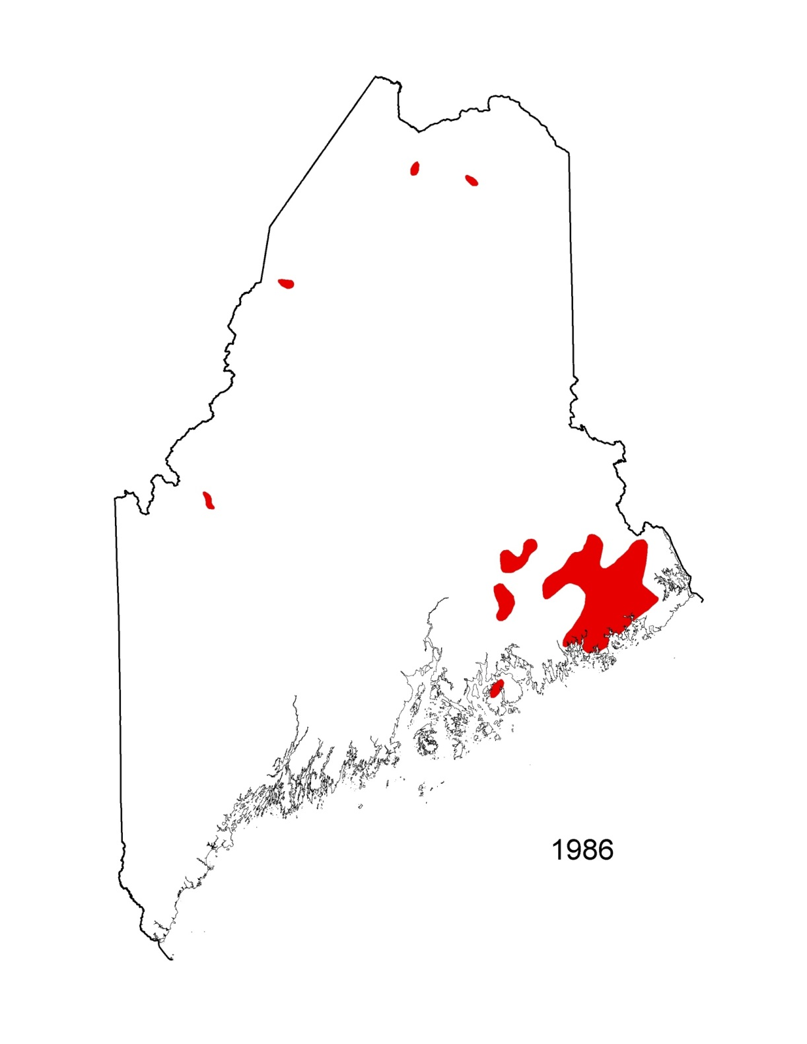

Slide 35
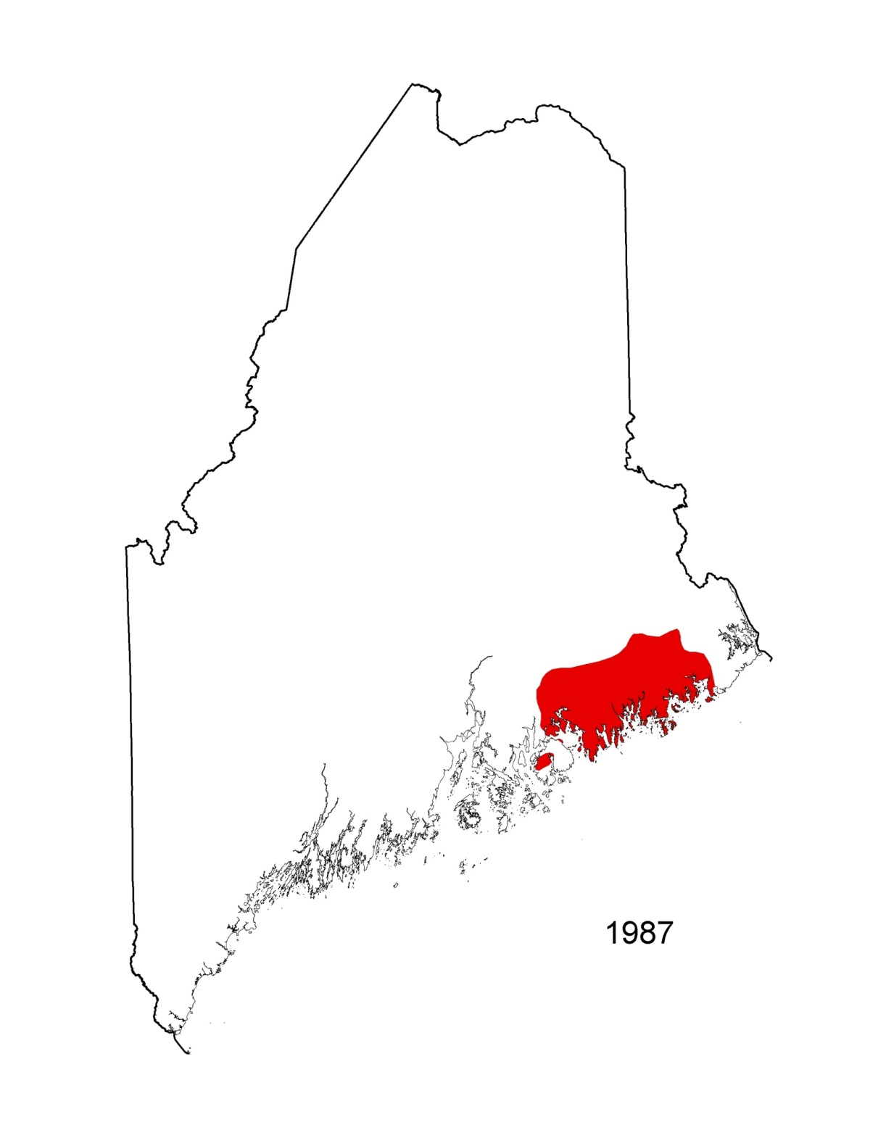

Slide 36
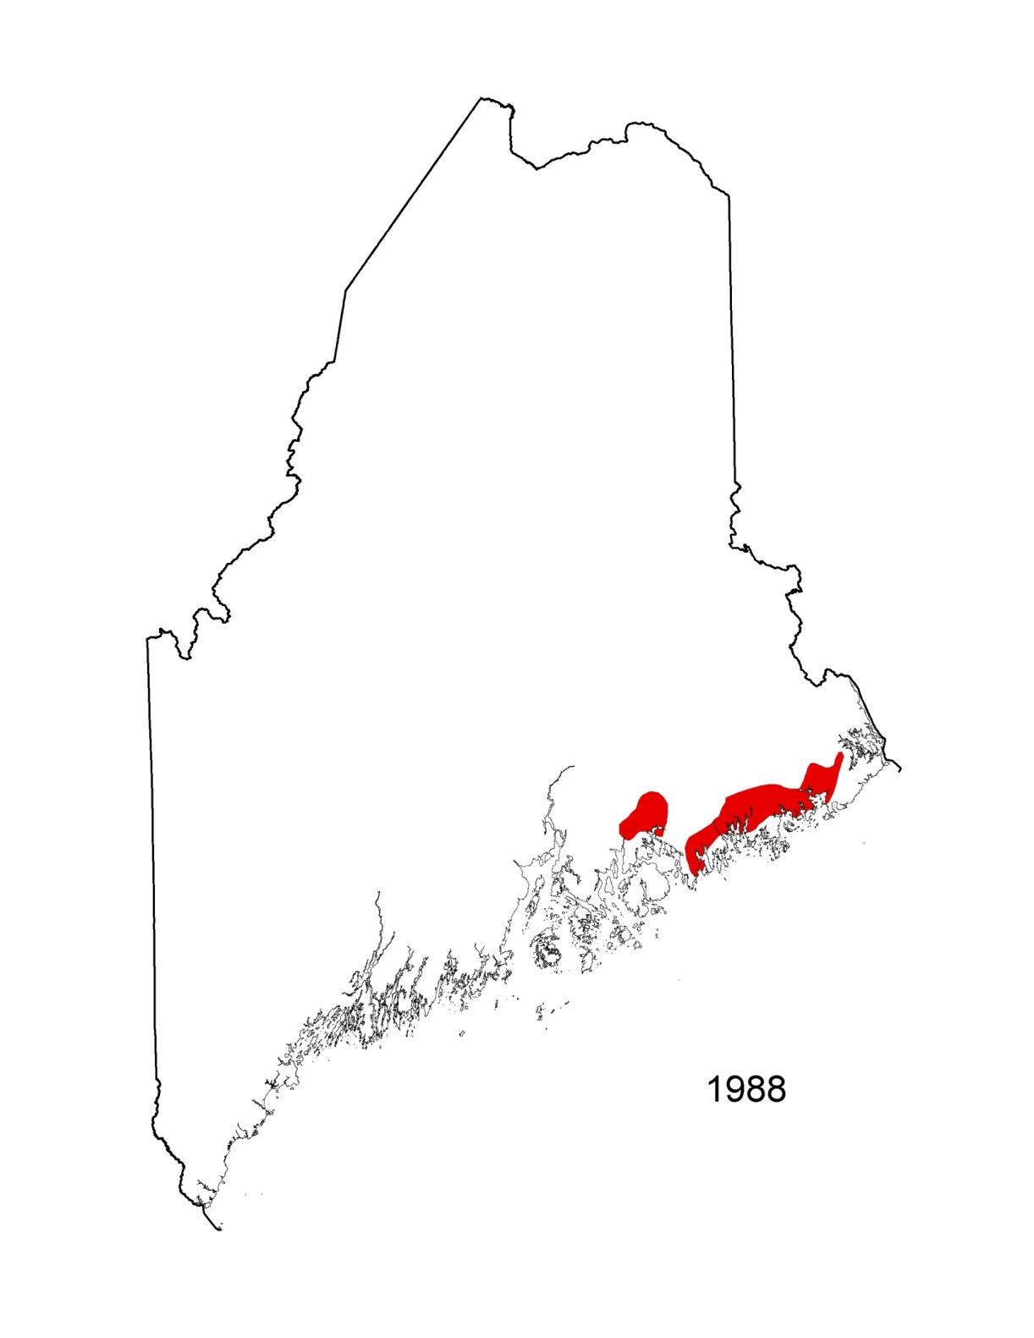

Slide 37
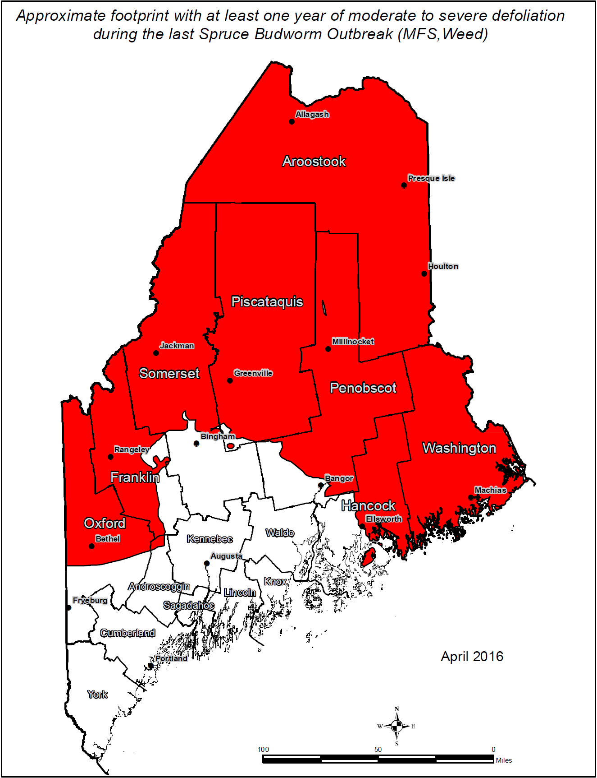

Slide 38
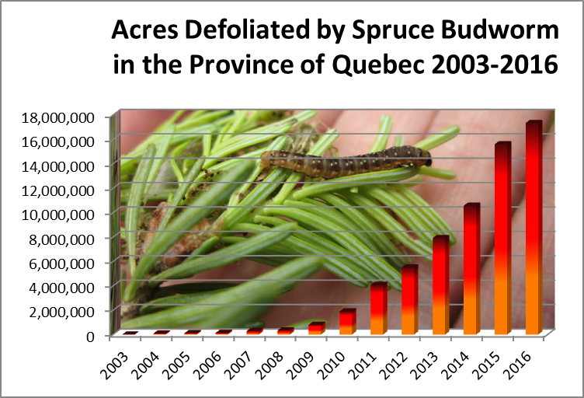
17.3 Million Acres in 2016 (Maine has ~ 17.8 mAcres Forestland)
Notes:
17,342,538 by comparison Maine Has ~17.8 million acres of forestland

Slide 39
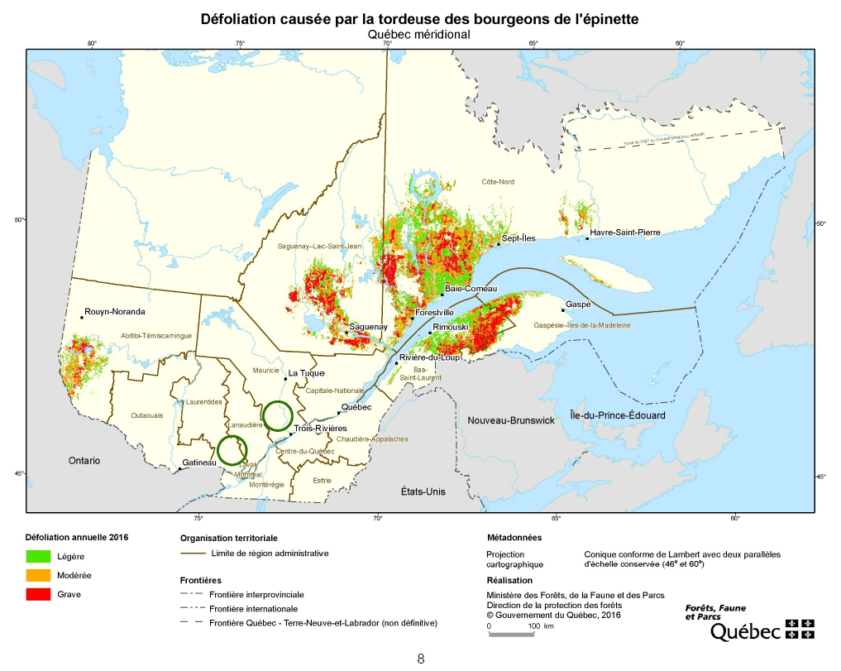

Slide 40
Cooperative Trap Network
American Forest Management
Appalachian Mountain Club
Baskahegan Company
Baxter State Park
Bill Jarvis
Bureau of Parks and Lands
Forest Society of Maine
Herbert C. Haynes Inc/Lakeville Shores Inc.
Huber Corporation
J.D. Irving Limited
Katahdin Forest Management
LandVest
Maine Forest Service
Orion Timberlands
Penobscot Nation
Prentiss & Carlisle
Seven Islands
US Forest Service
Wagner Forest Management
Weyerhaeuser Company
Supplies Distributed for 450 Sites
~300 Sites in to-date

Slide 41
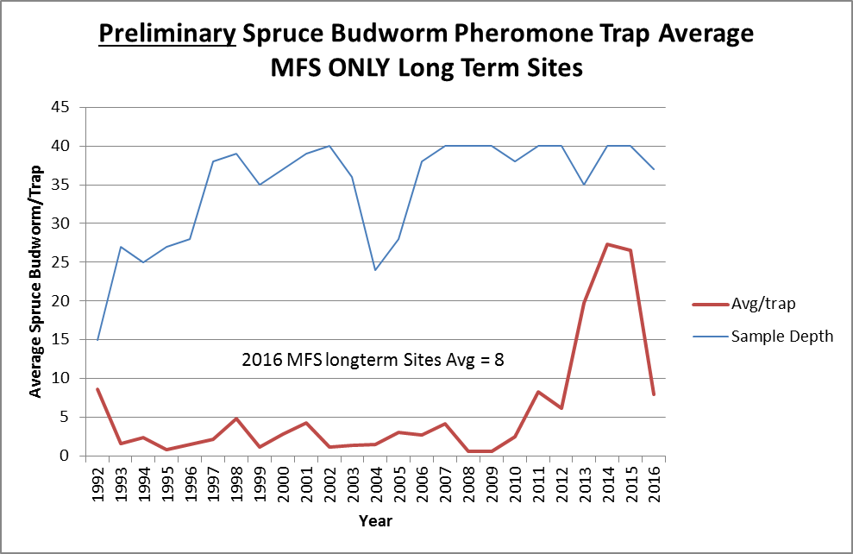
As of 10/18/2016
MFS sites only – Sites monitored over a longer term. Usual graphic has ~80 sites (many northern)--data not yet available for all sites.

Slide 42
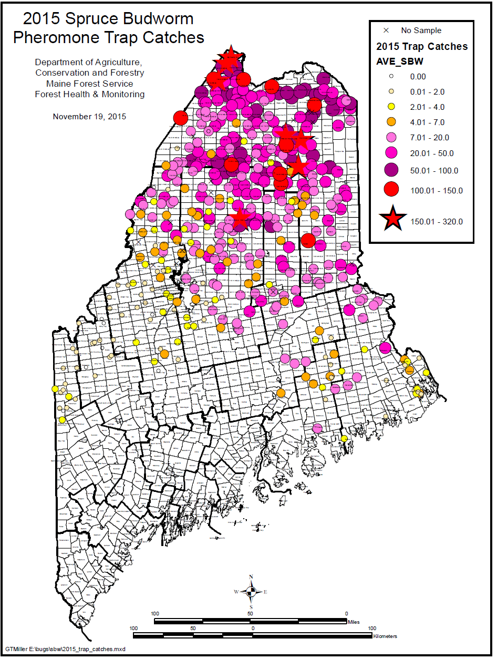
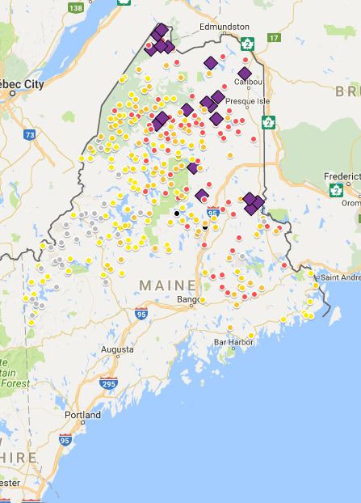
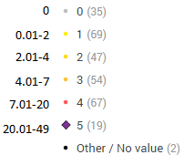

Slide 43
291 Sites reporting as of 10/18/2016 (expect ~430)

Slide 44
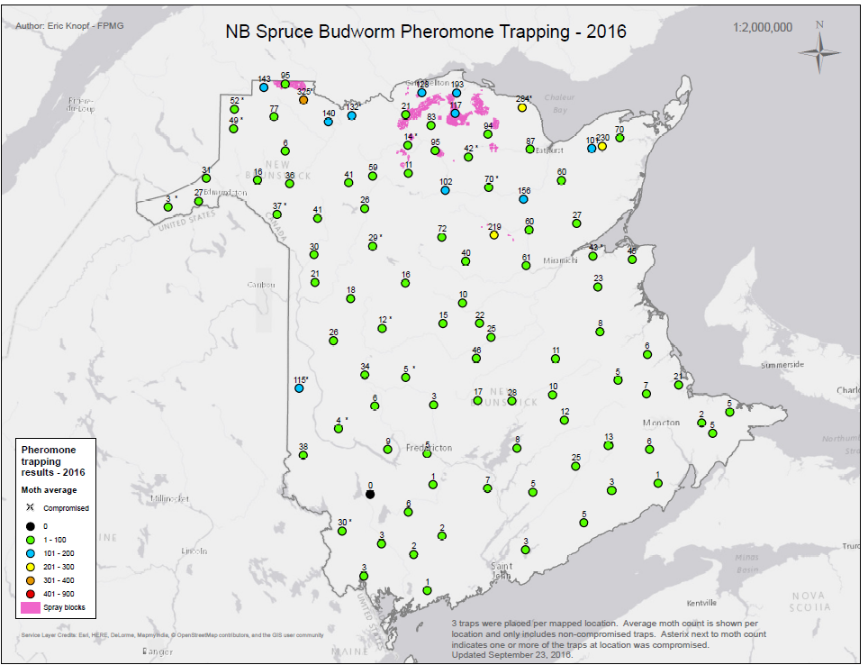
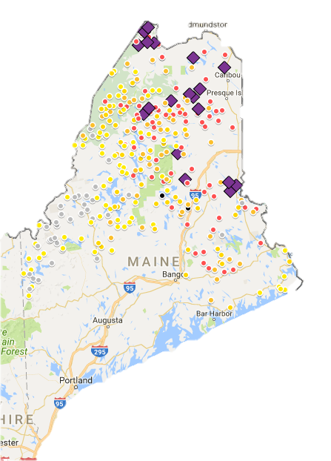
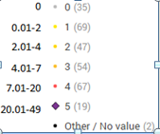

Slide 45
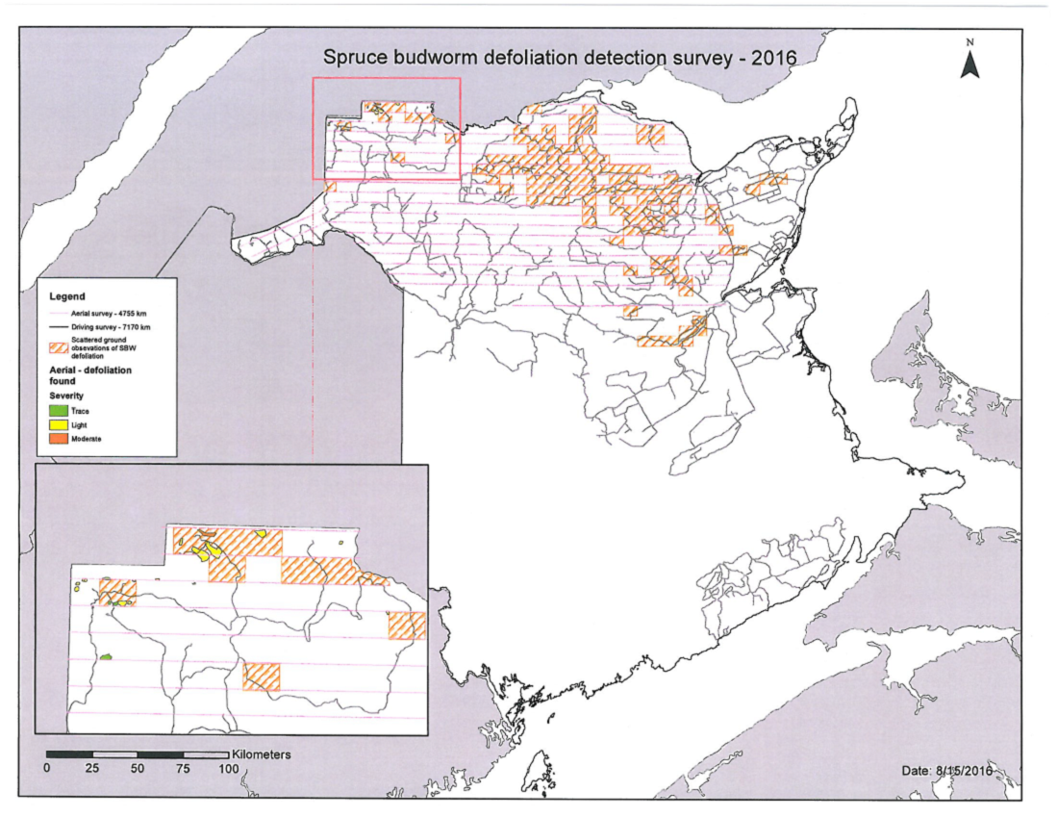

Slide 46
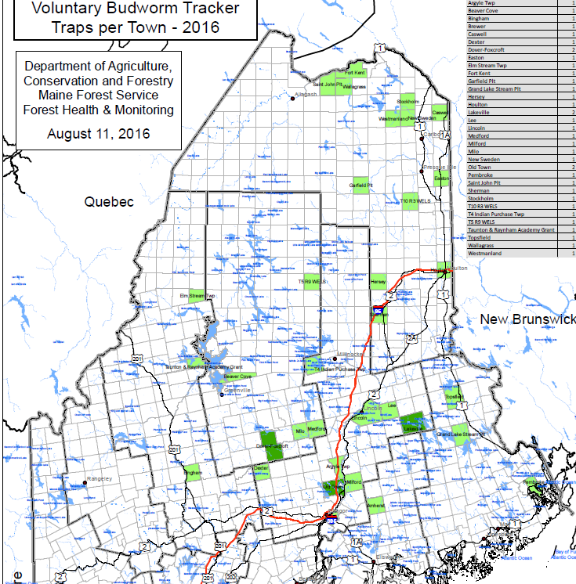
Budworm Tracker
Coordinated by Emily Owens (NR Canada)
37 sites, 34 Towns in Me

Slide 47
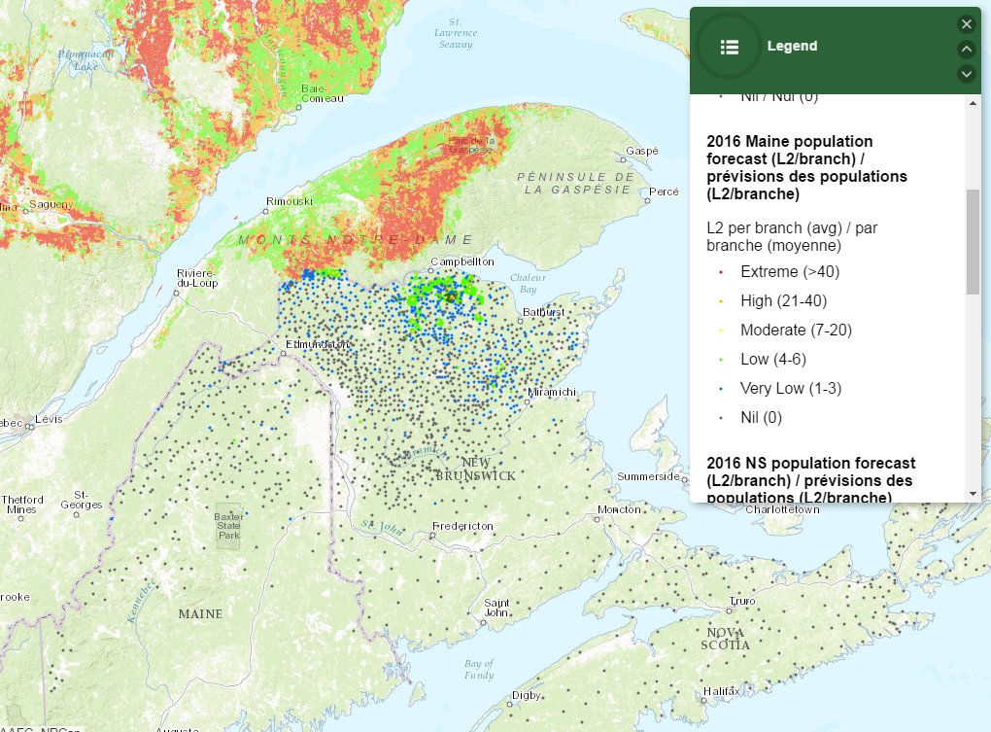
291 Sites reporting as of 10/18/2016 (expect ~430)

Slide 48
Resources for More Information
sprucebudwormmaine.org
Facebook:
sprucebudwormmaine16
maineforestservice.gov
Spruce budworm page
Conditions Reports
Healthyforestpartnership.ca
budwormtracker.ca
Facebook:
budwormtracker

